Slide 1
COPOLAD III:
Program, Progress, and Challenges
Borja Díaz Rivillas. Program Director COPOLAD.
February, 2024

Slide 2
Strategic Approach of COPOLAD
1. Multidimentional responses to Drug Policies
1. Strengthening National Drug Observatories
2. Reducing Drug Demand
7. Cross-Cutting Approaches: Rights and Innovation
More Humane and Effective Drug Policies
6. Emphasis on Public Policy Processes and Countries’ Strategic Plans
2. Multi actor/ coordination inter- institutional
4. Support for Bi-regional Coordination and Cooperation
3. Reducing Drug Supply
3. Multi-level: bi-regional, regional, multi-country, national, local
5. Strategic Partnerships with Key International Networks and Organizations
4. Mobilising Public Talent

Slide 3
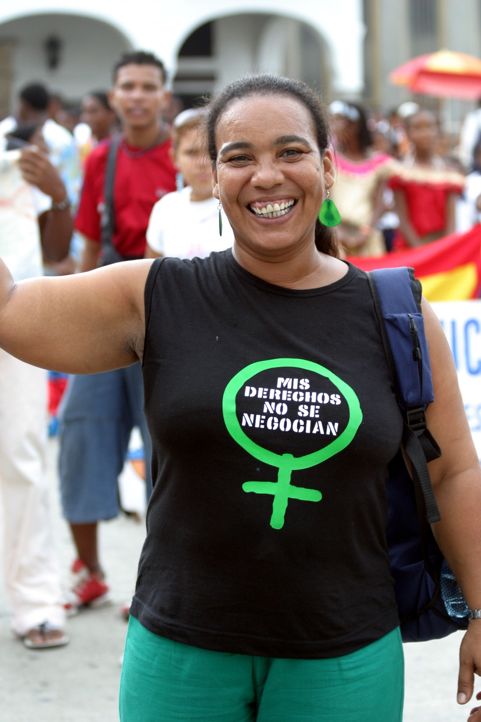
What Do We Do?
In line with the European Drug Strategy 2021-2025, the 2030 Agenda for Sustainable Development, and OAS Hemispheric Drug Strategy and Plan of Action 2021-2025
Technical Support
Study Visits
Capacity building
Meetings/ Workshops / Seminars
Research and Studies

Slide 4
Multi-Level Approach
Coordination Mechanism
CELAC – EU
Bi-Regional Approach
International network and organizations / CSO Alliances / Regional Thematic Work Groups
Regional Approach
National Public Policies Based on Roadmaps/ Definition, Implementation and Evaluation
National Approach
Community Approaches/ Active Listening and Assessment of Needs for Public Policy Alignment
Territorial Approach

Slide 5
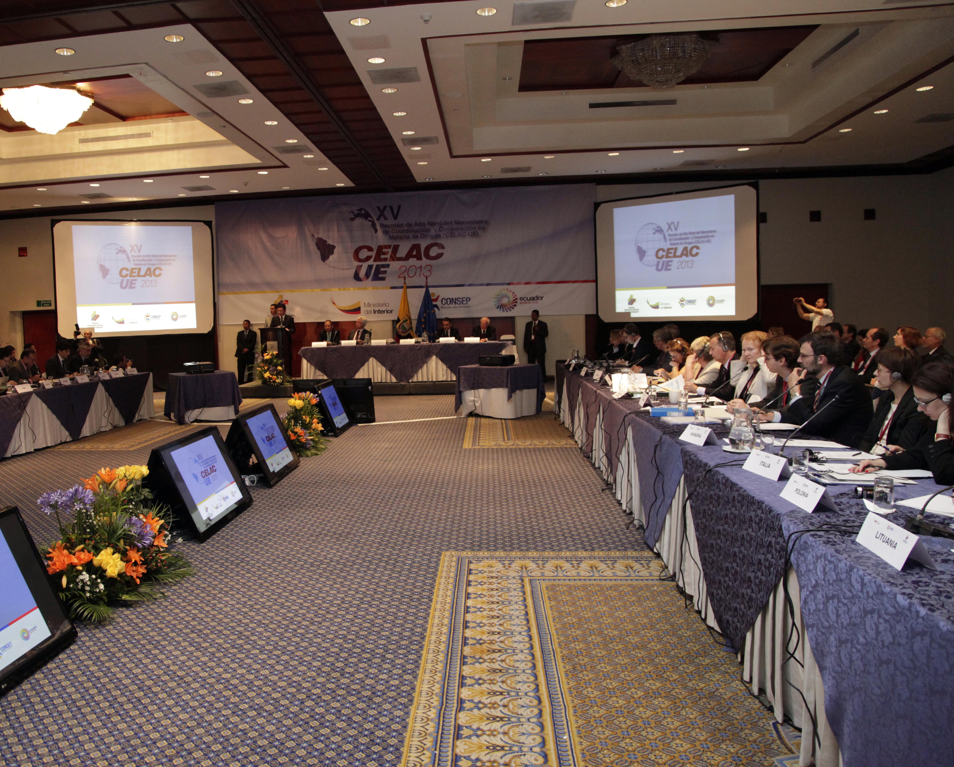
Bi-regional Approach: support to the CELAC – EU on drug policies
Support to thematic priorities agreed en la high-level meeting: microtrafficking and money laundering; women and drug policies.
Technical and logistical support to the mechanism’s annual high-level meetings
Provide expert support to the co-chairs for the preperation of the annual high-level meeting political declaration

Slide 6
Regional Approach: ss Strategic Support to International Networks and Organizations
Ibero-American Association of Public Prosecutors (AIAMP)
Latin American Financial Action Task Force (GAFILAT)
Conference of Ibero-American Countries’ Ministries of Justice
CARICOM IMPACTS Law Enforcement and Security Task Force
Caribbean Financial Action Task Force (GAFIC)

Slide 7
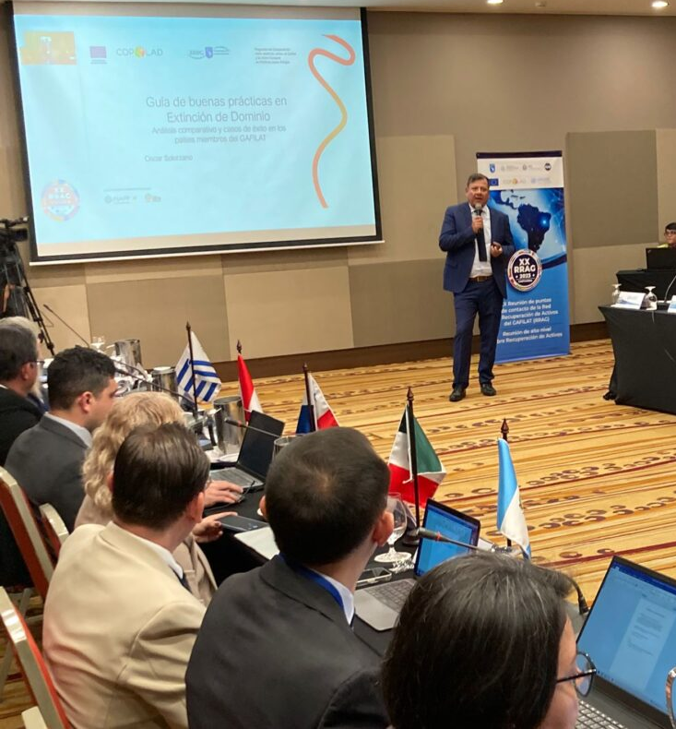
Regional Approach:
Collaboration with GAFILAT
Approval of the best practice guide on parallel financial investigations (december, 2023).
Approval of the best practice guide and recommendations on asset forfeiture and seizure without conviction (January, 2024).
Strengthening the secure information exchange platform of the GAFILAT asset recovery network.

Slide 8
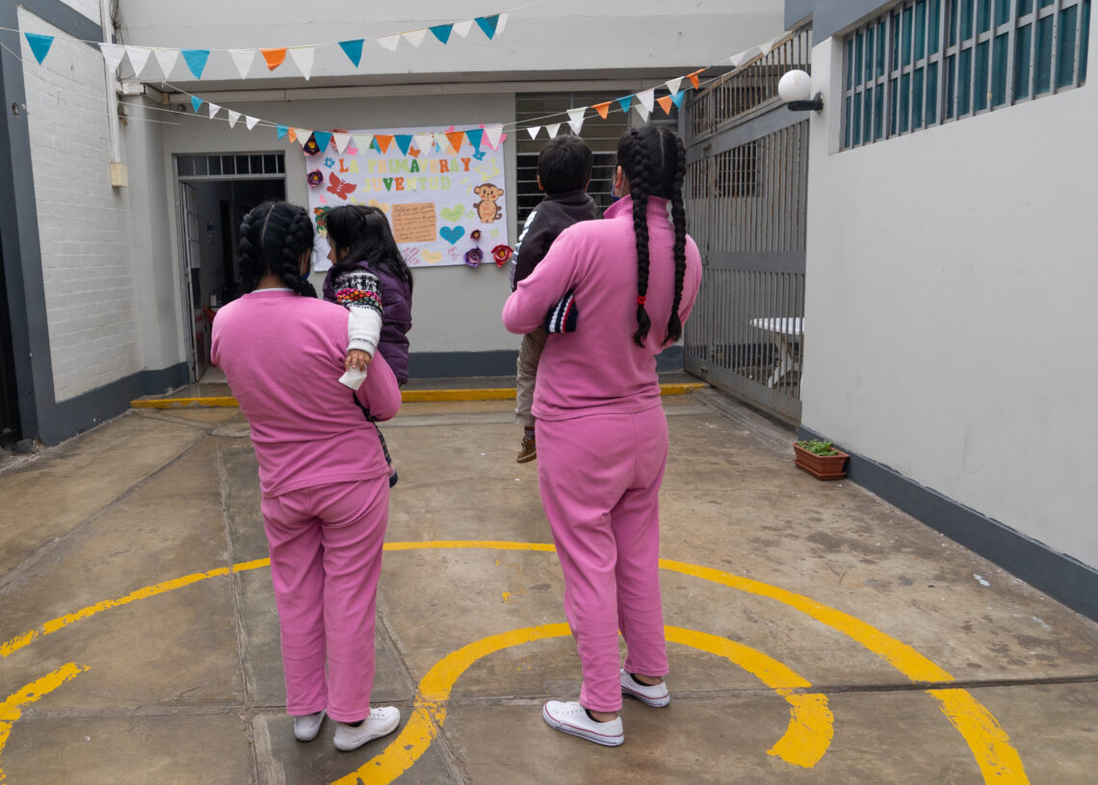
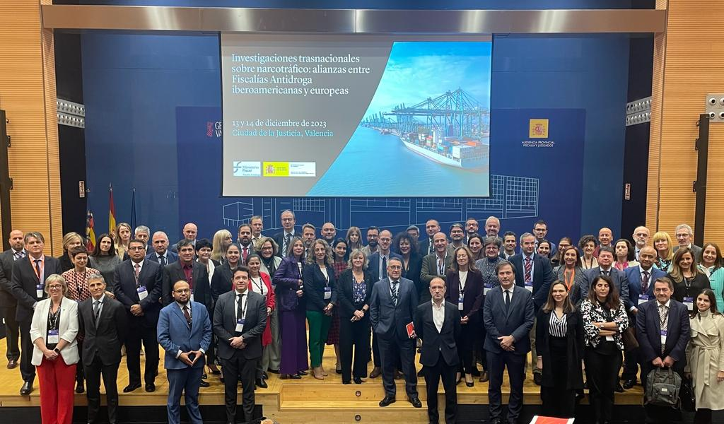
Regional Approach:
Collaboration with COMJIB and AIAMP
COMJIB. Approval of standards for greater proportionality and alternatives for minor drug offences.
AIAMP. Special investigative techniques and gender approach in investigations of human trafficking linked to drug trafficking.

Slide 9
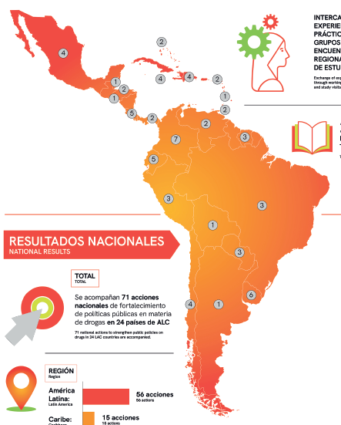
National Approach
We are part of 71 national roadmaps to strengthening the public drug policies in 24 Latin American and Caribbean countries.
26
24
21
Reducing Supply
National Drug Observatories
Reducting Demand
Latin America: 56 national road maps
Caribbean: 15 national road maps

Slide 10
National Public Policy Approach
Chile
New action plan from SENDA (2024)/ National Policy against Organized Crime (Dic. 2022)
Colombia
National drug policy 2023-2033 ‘By sowing life, we unearth drug trafficking”
Uruguay
The National Drug Strategy (2021 – 2025), the National Plan to address drug use in detention and and national plan for addressing individuals with alternative measures for drug-related offences.

Slide 11
Multi-Country Support:
Chemical Precursors
Countries: Colombia, Ecuador, El Salvador, Bolivia, Paraguay, Saint Lucia, Antigua and Barbuda.
Management and final disposal
Regulatory development
Software development to improve risk assesments.
Advanced university course of specialization in drug precursor control and investigation (CITCO-UNED)

Slide 12
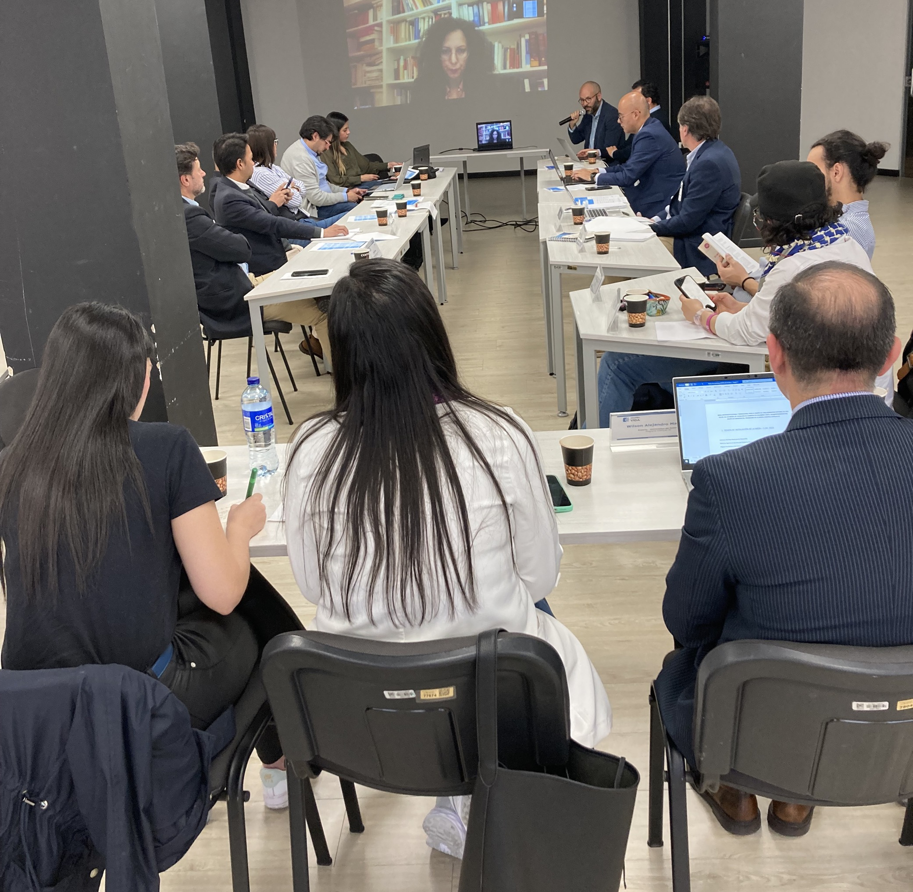
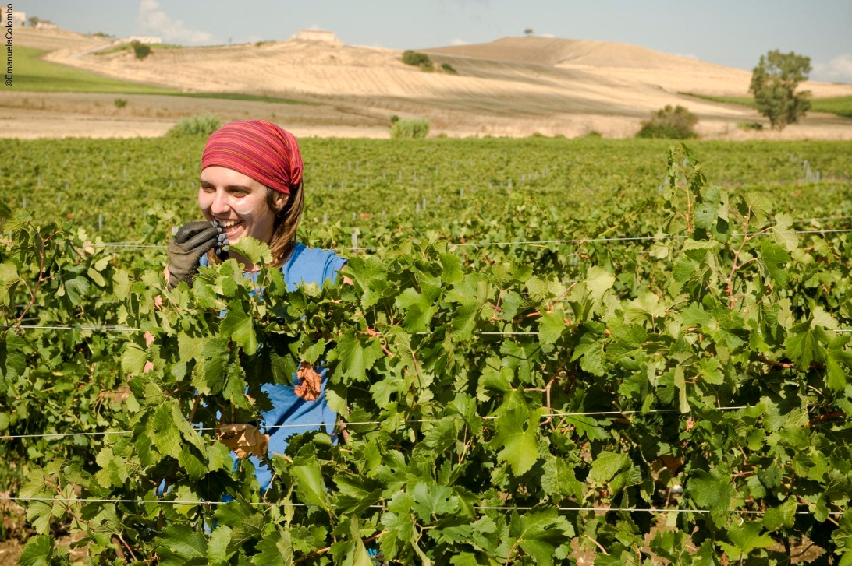
Multi-Country Support:
Social use of assets seized from drug trafficking: Colombia, Uruguay and Costa Rica. GAFILAT.
Launch of technical interinstitutional working group in Colombia: Special Assets Company – Ministry of Justice and Law, December, 2023

Slide 13
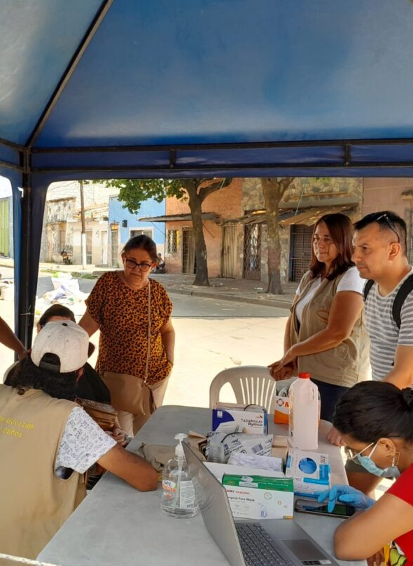
Territorial Approach
RAISS
Bahamas,
Belize,
Brasil,
Chile,
Colombia,
Costa Rica,
Jamaica,
Perú
Dominican Rep.
Suriname,
Trinidad & Tobago,
Uruguay.
14 Pilot projects have been designed in 12 countries for addressing territorial vulnerabilities linked to problematic drug use

Slide 14
Cross-cutting approach: gender and drugs
National
Regional
8 National Observatories incorporating the gender approach in the information systems;
Mexico: designing tools to promote sexually diverse inclusive care of problematic drug consumption.
Promotion of alternatives to detention and incarceration for women: Costa Rica and Paraguay.
Gender-perspective on the relation between drug trafficking and human trafficking. AIAMP.
Alternative development and gender. Guide and training course.
Study on ”Women and drug policies- A report on the situation in Latin America".

Slide 15
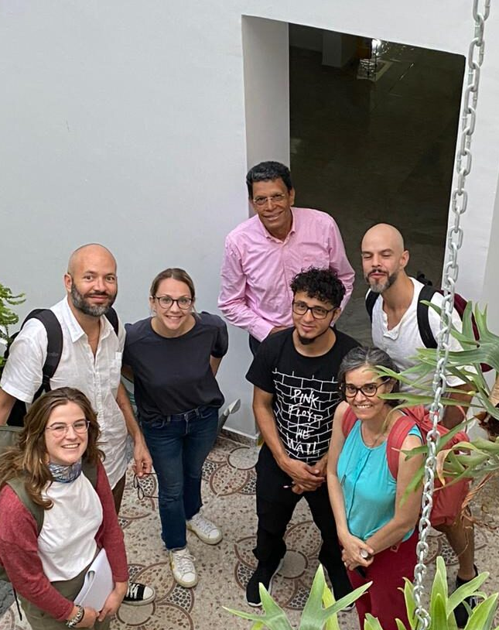
Cross-Cutting Approaches:
Innovation and Knowledge Management
Social innovation laboratories on drugs have been created in Chile (Maule) and in Colombia (Cali and Santander de Quilichao).
Study on Innovative Alternative Development Approaches
Monitoring and evaluating of changes in cannabis policies: Uruguay and Jamaica.
Study on environmental impacts of illicit drugs
Impact of drug policies on different dimensions of sustainable development (Uruguay, Jamaica and Costa Rica)

Slide 16
Peer to peer Learning
Region
Gender
America 70%
Caribbean 18%
Europe 10%
Supranational 2%
SICA Count 18%
To date, the program has carried out 68 knowledge and experience exchanges involving 1.070 individuals from 273 institutions in 32 countries in Latin America and the Caribbean, as well as 11 EU countries.
40%
60%
Activities
Institutions
Public Admin. 76%
Multilateral org. 6%
Ues/ OSC 8%
Companies 3%
EU institutions 6%
Autonomous 3%
32
18
10
Seminars
Tech. Support
Meetings
5
2
1
Training
Study Visits
Internships

Slide 17
Challenges and priorities 2024
1
Apply with success the national roadmaps, multi-country and regional alliances as fundamental elements to achieve the expected results.
Support the CELAC-EU mechanism en the prioritized topics set out in its 2024 declaration.
Promote complementarity and synergies with other regional and bilateral EU actions.
Promote involvement and participation in COPOLAD from more EU institutions/countries.
2
3
4

Slide 18
COPOLAD III:
Program, Progress, and Challenges
Borja Díaz Rivillas. Program Director COPOLAD.
February, 2024

