Slide 1
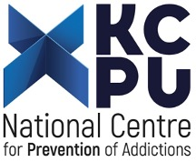
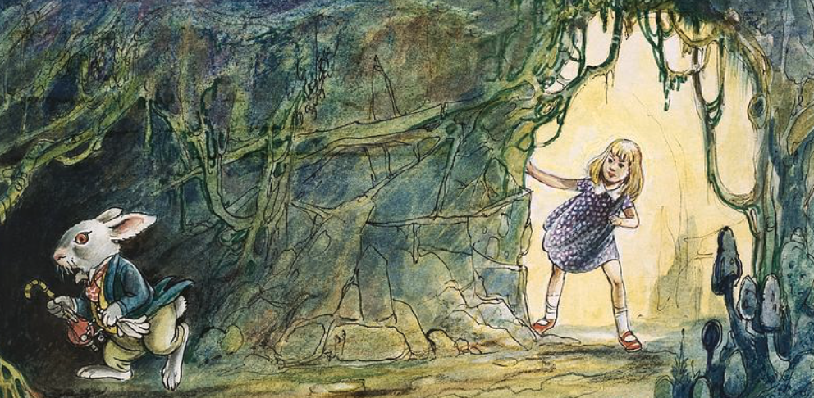
New Psychoactive Substances (NPS) and Early Warning System – Chasing the white rabbit?
Artur Malczewski PhD
Reitox National Focal Point
National Center for Prevention of Addictions
Shared challenges among EU-CELAC countries in the drugs field
EU – CELAC National Drug Agencies Meetings
Brussels, 8-10 October 2024

Slide 2
Early Warning System (EWS) in Poland
first attempts to establish the EWS: 2003-2004
officially launched in 2004 following accession to the EU
operates within the National Center for Prevention of Addiction (National Focal Point)
nationwide coverage
Information on NPS reported on an ongoing basis
e-mail (no extra IT and software solutions required)
agreement on the cooperation regarding the EWS on NPS
reporting to the EUDA

Slide 3
Information flow within EWS
EWS
EUDA
Central Forensic Science Laboratory of the Police
Forensic Science Institute (Krakow)
EUROPOL
National Medicines Institute
Ministry of Health
Internal Security Agency
Council on Counteracting Drug Addiction
Central Customs Laboratory
Central Border Guard Laboratory
Media
Harm reduction programmes (12)
Chief Sanitary Inspectorate
Drug Treatment Units
National Consultant on Clinical Toxicology
Notes:
3

Slide 4
Data and limitations
Data
Annual statistics within EWS,
Laboratory data on NPS-confirmed cases,
Limitations
Refer to samples sent for analysis at EWS network labs,
Fail to reflect the overall quantity of NPS seized in Poland,
Not all labs are in the network

Slide 5
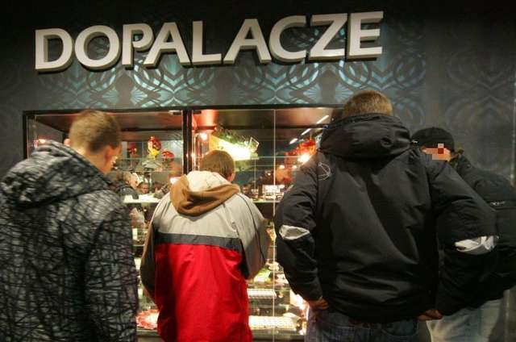
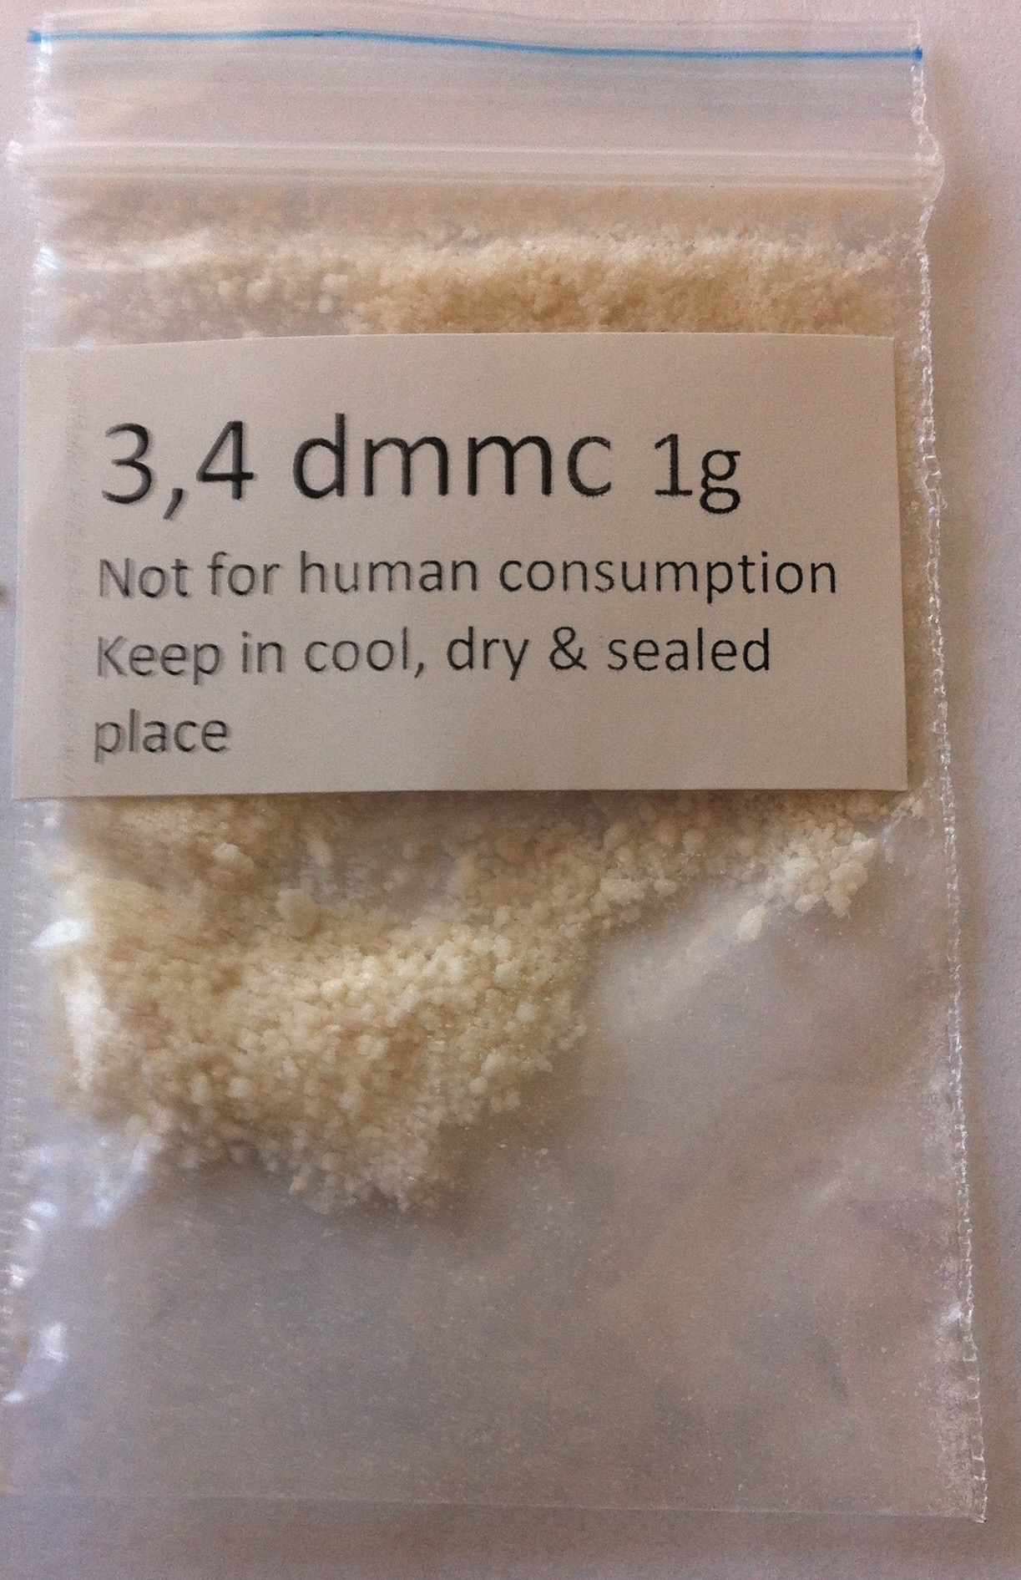
„Dopalacze” (boosters – polish name of NPS): brief history 2008-2010
before 2008 – limited number of information about the legal highs in Internet (users forums ect.)
beginning of 2008 – www.dopalacze.com (one name for whole group of new psychoactive substances in Poland: „booster”)
by the end of 2008 – 40 street shops in centres of major Polish cities
2009-2010 – Drug Law was amendment in aim to extent the list of controlled substances
Notes:
5

Slide 6
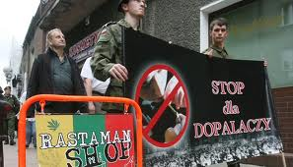
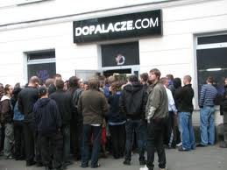
„Dopalacze” (boosters - NPS) – brief history 2010
In October 2010 over 1 300 of street shops were operating
according to the National Consultant in Clinical Toxicology in October 2010 there were 258 cases of poisonings suspected to be connected with legal highs (NPS)
13 October 2010: nationwide action of the Police and General Sanitary Inspectorate
Aim: to close all shops selling „legal highs”
In October 2010: 1378 shops were closed and 3576 were inspected
Notes:
In the second half of 2010 more signals of medical emergencies and hospitalizations most likely related to legal highs were being received from hospitals. In most cases they were the reports of the patients themselves. At the end of September, the media reported at least a few acute poisonings and two deaths caused by legal highs. There was no clear laboratory confirmation whether the deaths were related to legal highs.
A rapidly increasing supply of the legal highs which could be an alternative to drugs and the information of possible deaths and poisonings caused a strong social response in the form of local and national protests and campaigns. Being mindful of the above on 3 October the Chief Sanitary Inspector issued a decision to close down legal highs-related shops, wholesale companies and manufacturing companies by virtue of Articles 27.1, 27.2 and Article 31a of the Act of 14 March 1985 on State Sanitary Inspection. Act of 14 march 1985 on State Sanitary Inspection (Journal of Laws “Dz. U.” of 2006 No. 122, item 851, as further amended)
6

Slide 7
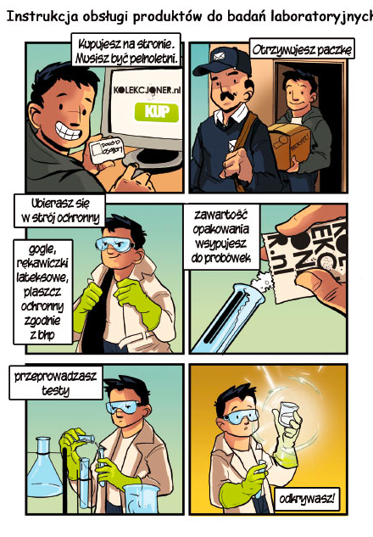
„Dopalacze“(NPS) – come back
Since 2011 – actions of the State Sanitary Inspection: inspections and closures of NPS stores, difficulties with collecting the penalties imposed,
2012 – new marketing methods: online stores Research Chemicals: sale of pure substances,
Since 2013 – increasing number of NPS-related poisonings in Poland, first clandestine NPS lab detected in Poland – two NPS labs in total,
2014 – over 100 NPS stores and one NPS lab detected, nearly 2500 NPS-related poisonings,
2015 – amendment to the Act on Counteracting Drug Addiction, July: 1966 NPS-related poisonings (including 5 deaths); 192 inspections of stores by the State Sanitary Inspection and Police, two NPS labs detected in Poland, Risk assessment group established
2016 – over 4300 poisonings, approx. 100 brick and mortar stores, two NPS labs detected in Poland,
2017 – still over 4300 poisonings, approx. 100 stores, two NPS labs detected,
2018 – new legislative solution on NPS: generic law (4 groups), probably 10 NPS-related deaths just prior to the promulgation of the new legislation.
2019 – next generic groups add to the Drug legislation
2020 - decreased the number of NPS poisoning to 1070
2021 - 17 labs of NPS detected
2022 – Record in number of NPS labs (synthetical cathinones) in Poland 29.
How to use research chemicals?
Notes:
In the second half of 2010 more signals of medical emergencies and hospitalizations most likely related to legal highs were being received from hospitals. In most cases they were the reports of the patients themselves. At the end of September, the media reported at least a few acute poisonings and two deaths caused by legal highs. There was no clear laboratory confirmation whether the deaths were related to legal highs.
A rapidly increasing supply of the legal highs which could be an alternative to drugs and the information of possible deaths and poisonings caused a strong social response in the form of local and national protests and campaigns. Being mindful of the above on 3 October the Chief Sanitary Inspector issued a decision to close down legal highs-related shops, wholesale companies and manufacturing companies by virtue of Articles 27.1, 27.2 and Article 31a of the Act of 14 March 1985 on State Sanitary Inspection. Act of 14 march 1985 on State Sanitary Inspection (Journal of Laws “Dz. U.” of 2006 No. 122, item 851, as further amended)
7

Slide 8
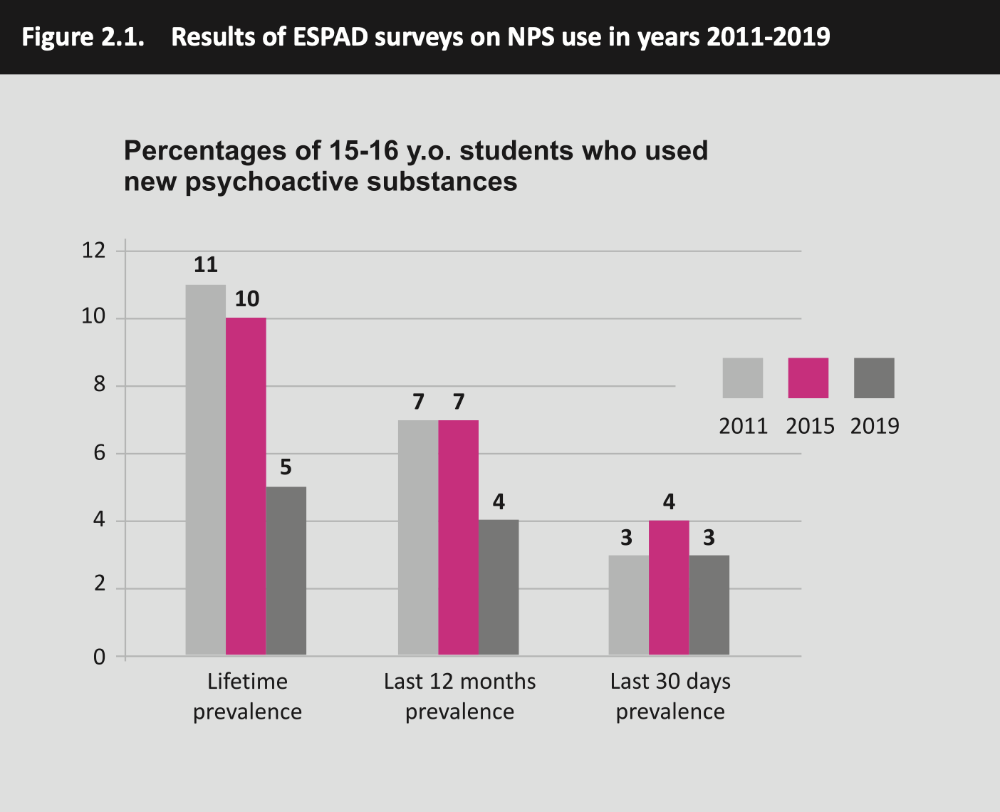
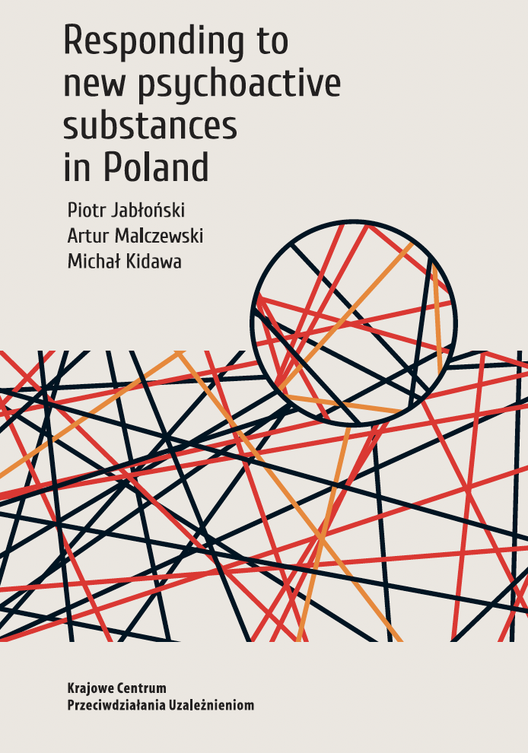

Slide 9
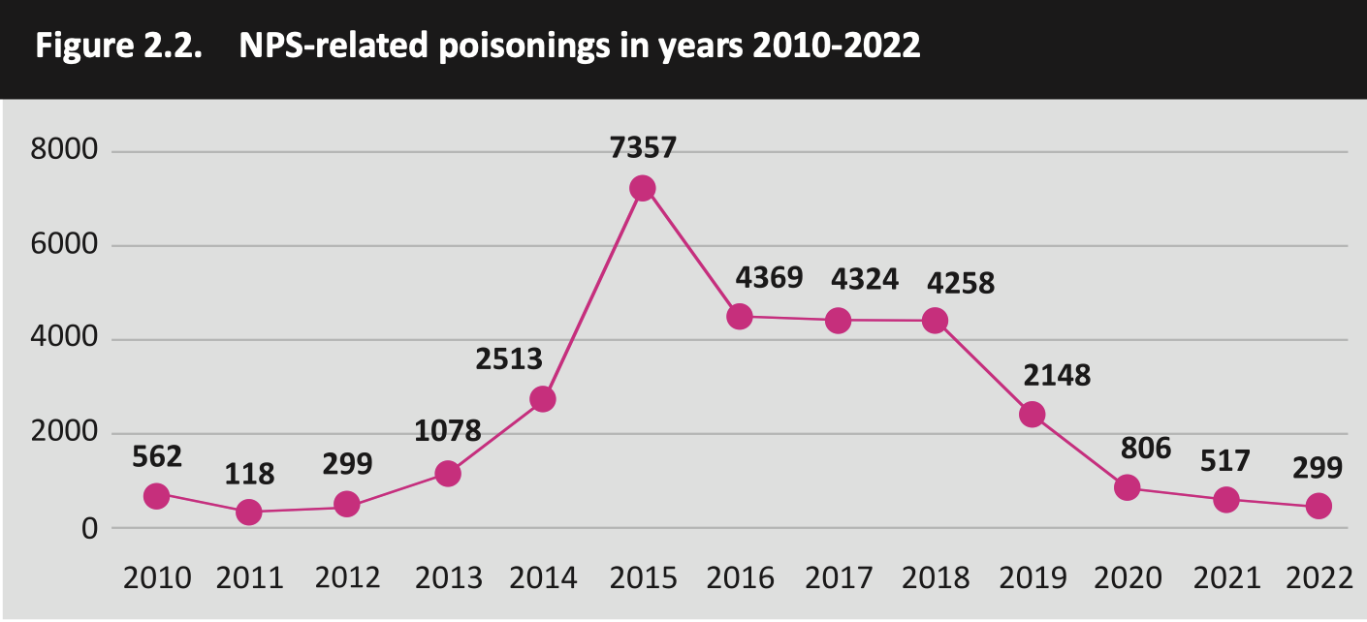

Slide 10
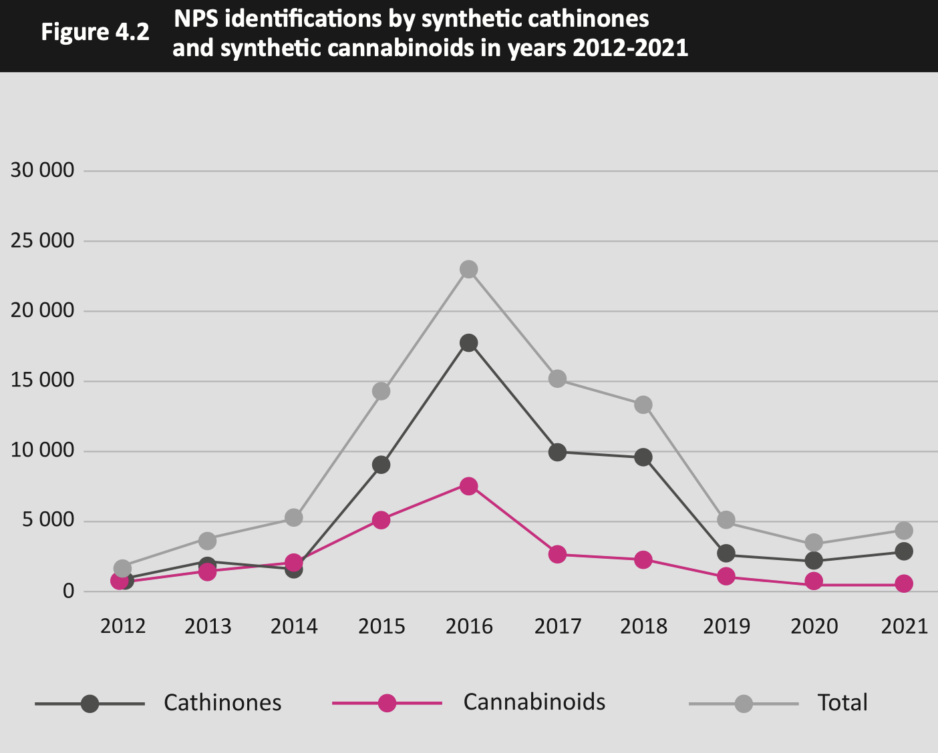

Slide 11
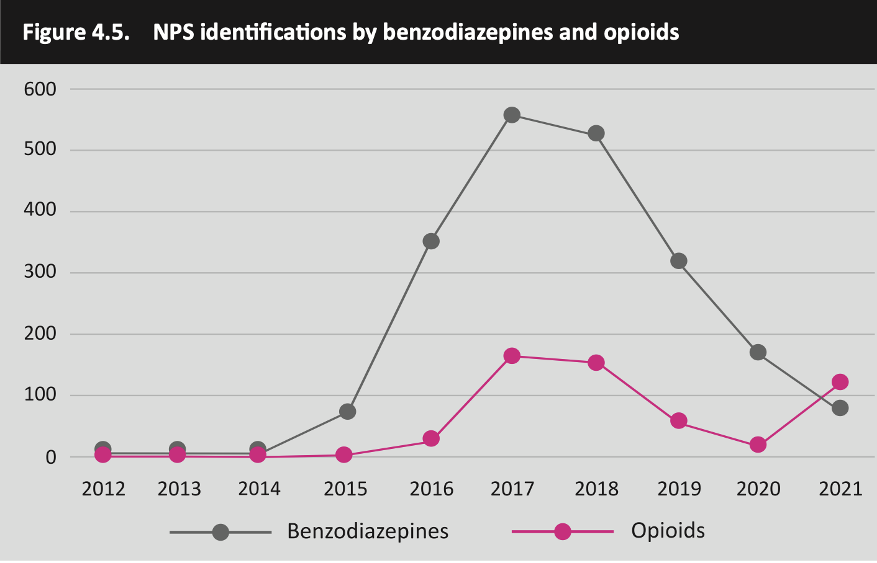

Slide 12
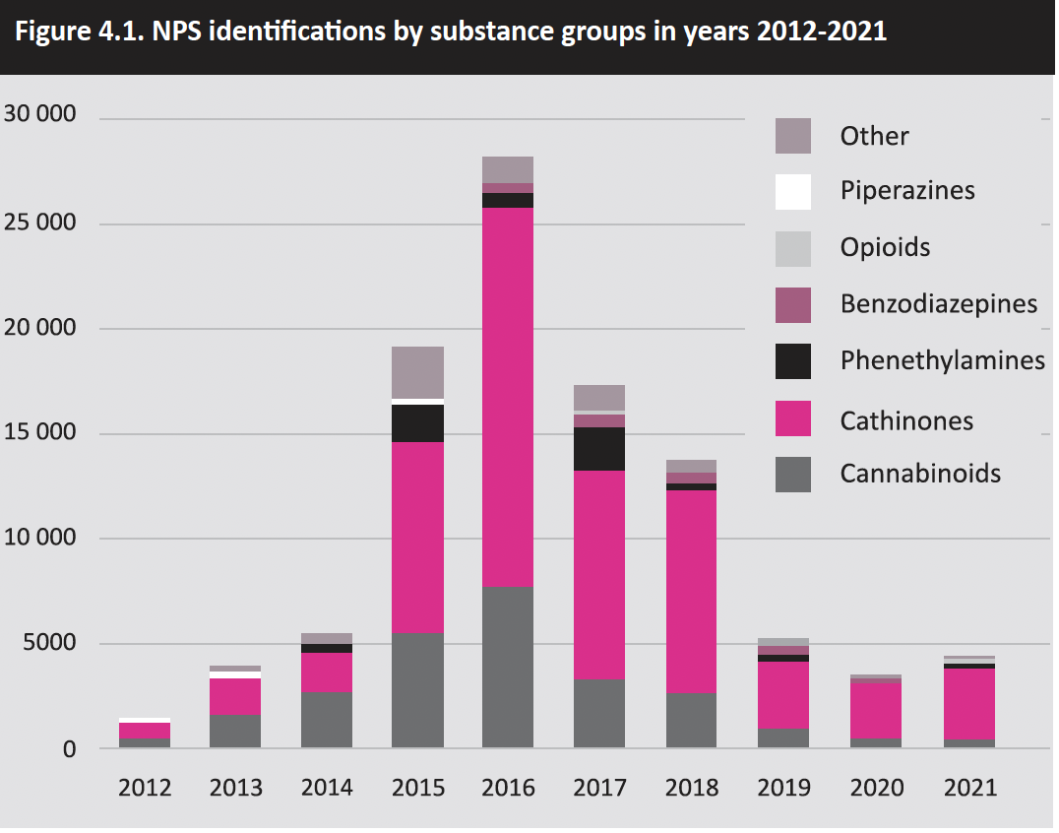

Slide 13
artur.malczewski@kcpu.gov.pl
https://kcpu.gov.pl/wp-content/uploads/2024/06/responding_2023.pdf

