Slide 1
Shared challenges among EU-CELAC countries in the drugs field.
EU-CELAC National Drugs Agencies Meetings
Brussels, Belgium 2024
New Psychoactive Substances (NPS) in México
Dr. Daniel Pech Puebla
Clinical Psychologist at the Mexican Observatory of Mental Health and Addiction

Slide 2
Early Warning System EWS-México
Objectives of the EWS
Maintain a constant and systematic surveillance in order to promptly identify possible threats related to NPS and other emerging drugs. Evaluate the risks and issue alerts in an agile manner, as appropriate.
Study dimensions
NPS
Permanent monitoring of risks associated with NPS and emerging drugs.
Emerging drugs
Already known substances
Adulterants
Generate effective responses, based on evidence
EWS
Provide useful information to services
Detection of substances in other scenarios
Cases treated in treatment centers
Chemical characterization in laboratories
Provide useful information to the entities in charge of designing, implementing and evaluating public policies on drugs

Slide 3
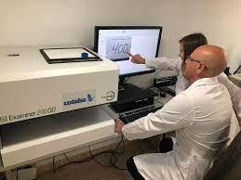
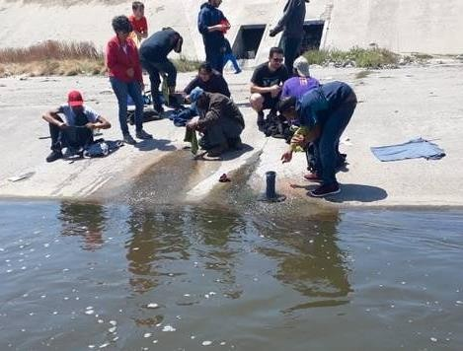
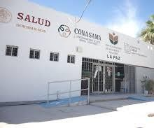
Early Warning System EWS-México
EWS network
Mexican Observatory of Mental Health and Addictions
Researchers in the field
Expert legal services/Laboratories
Key actors
Institutions
Organizations
Harm reduction programs
Treatment centers
Substance analysis programs

Slide 4
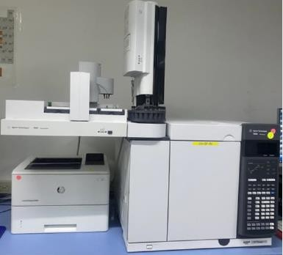
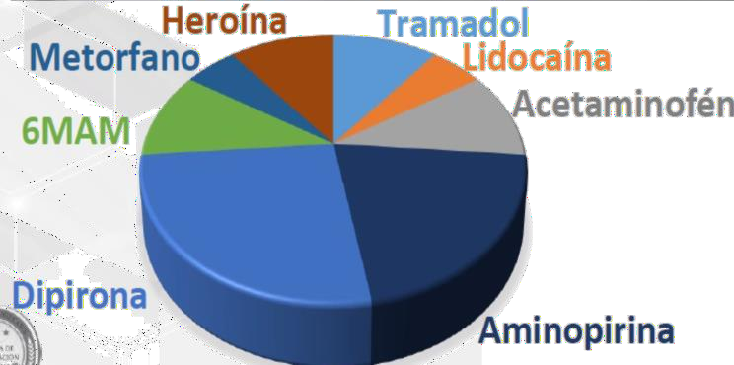
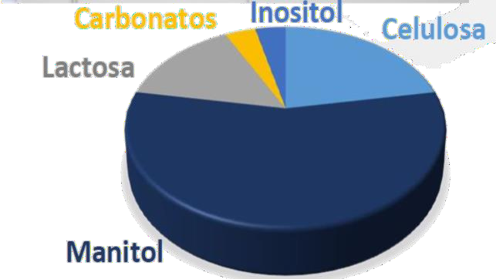
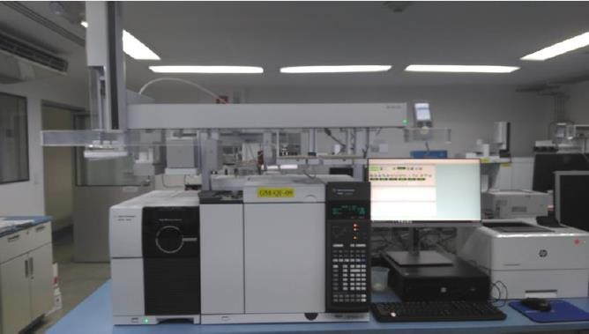
Findings. Fentanyl and analogues
Year | NPS reported by the forensic laboratory of the Republic Attorney General’s Office
2022 | Fentanyl analogues Butyrfentanyl
2023 | Fentanyl analogues 3-Fluorofentanyl Despropionyl 4-fluorofentanyl Despropionylfentanyl
Chemical profiling of fentanyl
Source: CFIC, 2024.
Adulterants
Diluents
Source: CFIC, 2023.

Slide 5
Findings. Fentanyl and analogues
Fentanyl seizures in México from 2015 to 2023
Care services demand due to fentanyl use from 2013 to 2023
2,500
600
518
2,018
2,086
500
2,000
1,848
Kilograms
400
333
1,500
Cases
1,242
300
1,000
200
184
491
100
72
500
341
25
5 3 4 1
1
10
40
0
11
20
2013 2014 2015 2016 2017 2018 2019 2020 2021 2022 2023
0
2015
2016
2017
2018
2019
2020
2021
2022
2023
Due to its nature, fentanyl is a substance of great interest to the EWS in México. Although a significant growth in supply has been observed, care services demand is very low (.28% in 2023), but it is also increasing.

Slide 6
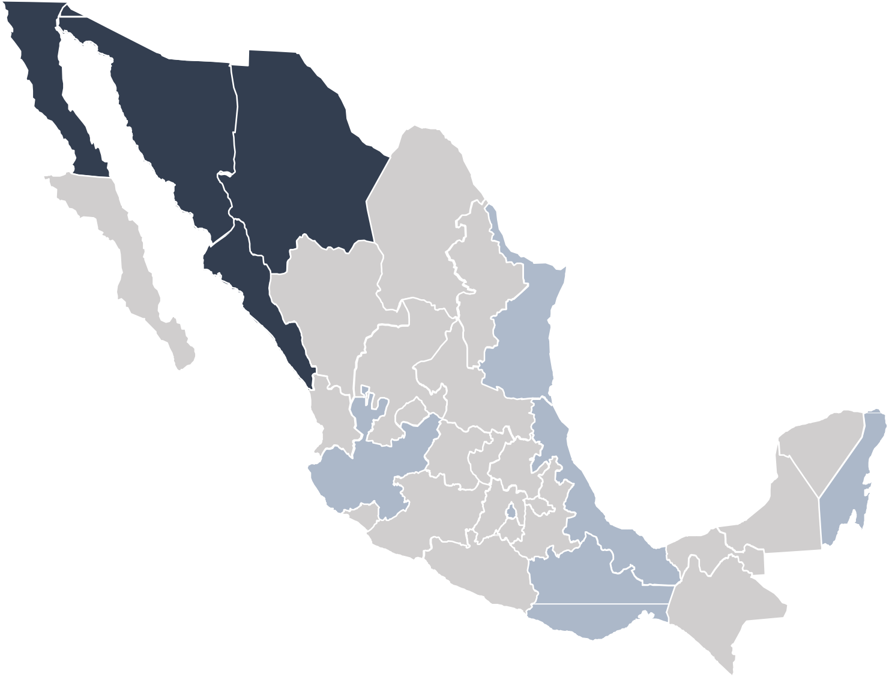
Findings. Fentanyl and analogues
The use of fentanyl is mainly located at the northern border of México.
1
In 2023, an emerging code (U.94) was implemented in all health units and services, to detect fentanyl poisoning.
Baja California
211
Sonora
18
Chihuahua
173
11
EMERGENCIES U94 FENTANYL INTOXICATION
State | 2023 | 2024
Baja California | 4 | 7
Ciudad de México | 1 | 1
Jalisco |  | 1
Morelos | 1
Oaxaca |  | 1
Quintana Roo | 1 | 3
Sinaloa | 3 | 10
Sonora | 2
Tamaulipas |  | 1
Veracruz |  | 1
Total | 12 | 25
1
Baja California Sur
Coahuila
Sinaloa
45
Durango
Nuevo León
1
Tamaulipas
Zacatecas
1
Services provided in treatment centers
6
S.L.P.
Nayarit
Aguascalientes
Guanajuato
Qro
Hidalgo
Yucatán
Jalisco
4
Emergencies
2
Colima
2
Veracruz
DEATHS ASSOCIATED WITH U94 FENTANYL INTOXICATION
State | 2023 | 2024
Baja California |  | 1
Sinaloa |  | 1
Sonora | 1
Total | 1 | 2
Michoacán
Edo. Mex
CDMX
Tlaxcala
Q. Roo
Deaths
MorelosPuebla
Campeche
Tabasco
2
+15 cases in poisoning centers (under review)
Guerrero
Oaxaca
1
Chiapas

Slide 7
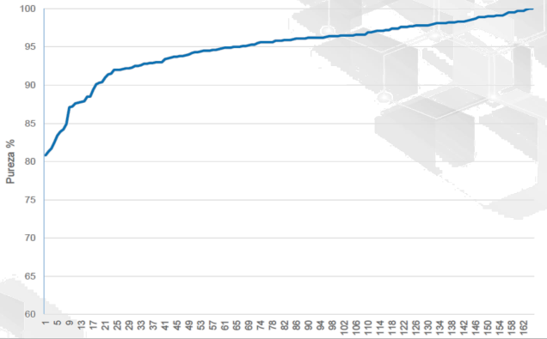
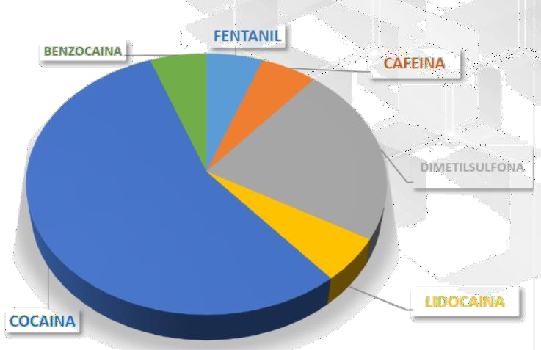
Findings. Methamphetamine
Main substance of consumption among those seeking care
Chemical profiling of methamphetamine
Methamphetamine purity
services. Laboratories are finding high substance purity.
50
Treatment demand and main impact drug 2013-2023
49.1
45.7
46.2
45
40
37.3
36.1
34.8
34.3
35
28.1
27.7
28.8
26.3
30.3
30
27.2
28.5
Alcohol
26
25.4
24.5
24.6
Marihuana
Cocaína Inhalables ETA
Tabaco
Adulterants
25
23.4
23.4
20.4
23.6
21.8
20
18.4
14.5
16.1
15
11.2
9.2
6.6
13.3
12
13.3
13.3
9.5
9.1
6.6
9.9
7.5
4.5
8.8
6.6
4.6
9.8
8.2
Alucinóge nos
10
8
8.4
7.2
8
6.8
5.3
6.8
4.4
7.1
6.8
6.2
4.6
5
4.3
3.6
 | 1.2 | 0.9 | 0.5 | 0.6 |  |  |  |  | 0.6 | 0.2 | 0.2
0
 | 2013 | 2014 | 2015 | 2016 | 2017 | 2018 | 2019 | 2020 | 2021 | 2022 | 2023
 | (148,169) | (146,750) | (142,189) | (142,923) | (95,223) | (144,931) | (162,530) | (101,142) | (132,988) | (167,905) | (179,342)
 |  |  |  |  |  | Year/n
Methamphetamines: there was an increase in care services demand of 416% in the last decade.

Slide 8
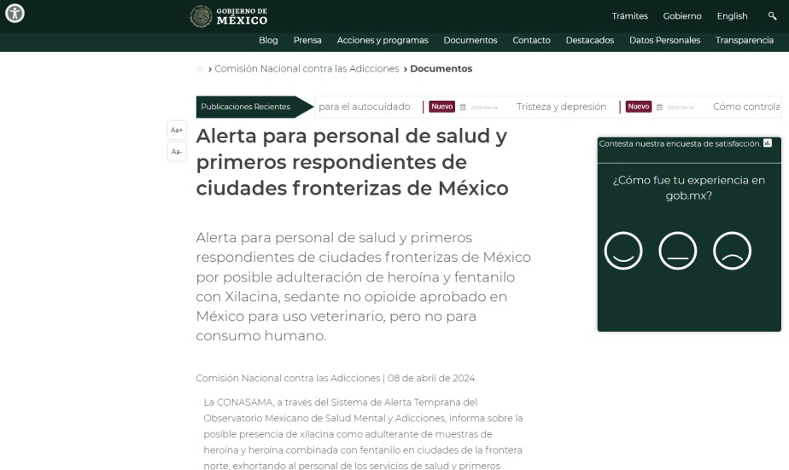
Other substances and emerging phenomena
Care services
Year | Other NPS reported by the forensic laboratory of the Republic Attorney general’s Office
2022 | Substances of plant origin Ayahuasca
2023 | Phencyclidine-type substances Ketamine Phenethylamines 1-Phenethylamine 2,3-Methylenedioxyamphetamine 2,3-Methylenedioxymethamphetamine 2C-B-FLY
80
70
60
50
40
Cases
Source: CFIC, 2024.
30
20
10
0
2015 2016 2017 2018 2019 2020 2021 2022 2023

Slide 9
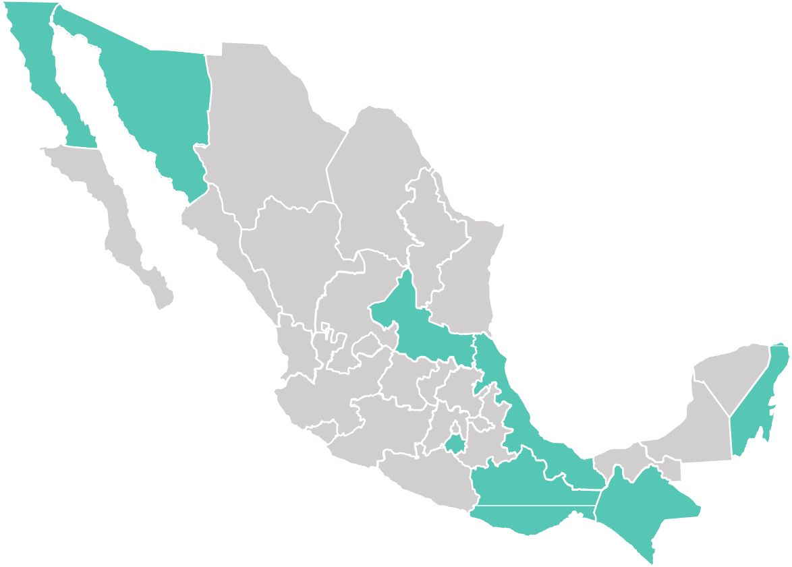
Other substances and emerging
phenomena
Psychedelic tourism with natural entheogens
Baja California
Sonora
Ayahuasca
Salvia
Sonoran Desert
Toad
Virgin seeds, Ipomoea violacea
Iborgaine
Chihuahua
Baja California Sur
Coahuila
Sinaloa
Durango
Nuevo León
Tamaulipas
Zacatecas
6
S.L.P.
Peyote
Nayarit
Aguascalientes
Jalisco
Guanajuato
Yucatán
Qro
Hidalgo
Edo. Mex
Michoacán ^{Tlaxcala}
Q. Roo
Retirement centers
Colima
CDMX
Veracruz
Campeche
MorelosPuebla
Tabasco
Guerrero
Oaxaca
Chiapas

Slide 10
Some final thoughts
The phenomenon of drug supply in México has changed in the last ten years. Currently, the synthetic drug market is predominant.
México has reported the presence of 36 NPS.
Methamphetamines are the most consumed substances among those
who attend to treatment.
The use of opioids such as fentanyl is an emerging phenomenon and is
currently located mainly at the northern border.
There are other phenomena of interest, such as the adulteration of drugs with Xylazine, the use of Tramadol, or psychedelic tourism.

Slide 11
¡Thank you!
Dr. Daniel Pech Puebla daniel.pech@salud.gob.mx

