Slide 1
Shared challenges among
EU/CELAC regions in the
drugs field -
Face-to-face meeting of EU/CELAC Drugs Agencies in Brussels.
Brussels, Belgium
8-10 October 2024

Slide 2
SESSION 3 –
National Drug Observatories and NPS.
Importance of EWSs.
Early Warning Systems as a key area of ​​strengthening the National Drug Observatories
Lines of work of the COPOLAD Program
Graciela Ahumada – Task Force for the Strengthening of NDOs – COPOLAD III
SHARED CHALLENGES AMONG EU/CELAC REGIONS IN THE DRUGS FIELD -
FACE-TO-FACE MEETING OF EU/CELAC DRUGS AGENCIES IN BRUSSELS.

Slide 3
COPOLAD I 2011-2014
Analyze the existing situation in different countries in relation to information collection systems on new drugs or new drug uses (Rapid Alert Systems).
Regulations and recommendations:
1997 EU Joint Action on New Synthetic Drugs
(detect/evaluate risks/control measures)
Definition of NDS
2005 EU NSP
Δ number of users and NSP, ≠ motivations, Δ serious/fatal poisonings
2012 Commission on Narcotic Drugs/UN Resolution 55/1
Creation of the bases for the establishment of a Rapid Alert Network on new substances or new drug uses, which allows agile communication between LA and the EU
Leading country: Brazil
Support: EMCDDA, OID-CICAD, GLOBAL SMART-CICAD
Colombia (2013) Uruguay (2014)
SHARED CHALLENGES AMONG EU/CELAC REGIONS IN THE DRUGS FIELD -
FACE-TO-FACE MEETING OF EU/CELAC DRUGS AGENCIES IN BRUSSELS.

Slide 4
Working group → Colombia, Uruguay and Trinidad & Tobago,
Support → Portugal, Rep. Checa and Polonia
State of the situation → characteristics and scope of the SAT on drugs in Argentina, Brazil, Colombia, Chile, Ecuador, Peru and Uruguay and in the Caribbean countries: Antigua and Barbuda, Barbados, Jamaica and Trinidad and Tobago (Sept. 2017)
Work meetings, training and preparation of the Implementation Manual
Strengthening of EWS→ Colombia, Uruguay, Argentina, Chile and Trinidad & Tobago
Implementation → Jamaica
Initial Phase → Bahamas, Ecuador and Perú
COPOLAD II 2016-2020
Activity 1.3. “Promotion and facilitation of the creation of national Early Warning Systems in CELAC countries”
Promote the adoption of sustainable information exchange agreements between National Agencies, ONDs and other interested parties in CELAC countries, who can provide information to identify and address the challenges posed by new drugs or new drug uses.
Joint work with OID-CICAD, EMCDDA, GLOBAL SMART-UNODC Y COPOLAD
DESAFÍOS COMPARTIDOS ENTRE LAS REGIONES UE/CELAC EN MATERIA DE DROGAS -
REUNIÓN PRESENCIAL DE AGENCIAS DE DROGAS UE/CELAC EN BRUSELAS.

Slide 5
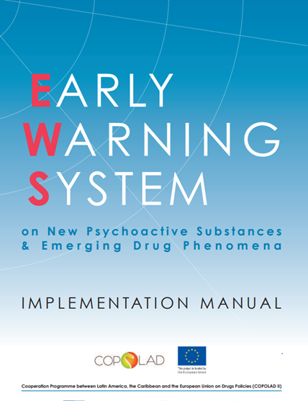
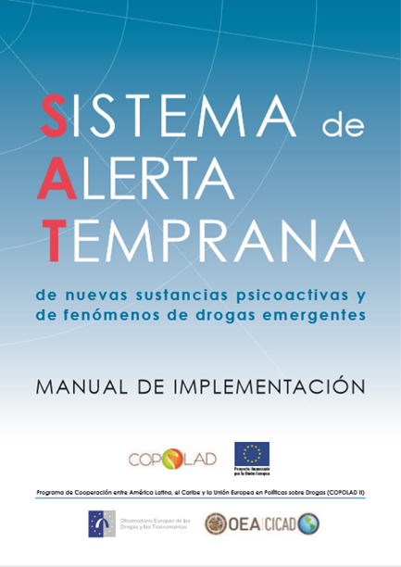
Manual for the LAC NDOs
DESAFÍOS COMPARTIDOS ENTRE LAS REGIONES UE/CELAC EN MATERIA DE DROGAS -
REUNIÓN PRESENCIAL DE AGENCIAS DE DROGAS UE/CELAC EN BRUSELAS.

Slide 6
Co-organized workshops → EUDA-COPOLAD - OID/CICAD with the support of SENDA. Chile, April 2023.
Analytical capacity of the National Early Warning Systems and the National Drug Observatories: updates and new perspectives.
Seminar and launch of the SAT in Jamaica, together with CICAD. February 2024.
Online workshop: Strengthening capacities in Early Warning Systems. March 2024
Support for the design of wastewater studies:
Argentina, Chile and Uruguay
Web survey design support in Uruguay
Online Training Prospective Analysis - Foresight
October 15/2024 Caribbean countries
COPOLAD III 2021-2024
Work line 1.5: Development and strengthening of national Early Warning Systems, led by EUDA
Training in new methodologies:
Wastewater analysis
Web surveys
Prospective analysis – Foresight methodology
DESAFÍOS COMPARTIDOS ENTRE LAS REGIONES UE/CELAC EN MATERIA DE DROGAS -
REUNIÓN PRESENCIAL DE AGENCIAS DE DROGAS UE/CELAC EN BRUSELAS.

Slide 7
SATS CHALLENGES
THINK IN SAT KEY
CONSOLIDATE
NETWORKS
SCIENCE
COLLABORATIVE
Thank you for the attention!
INCIDENCE
IN THE
POLICIES
PUBLIC
SURVEILLANCE OF
THREATS
ENDOGENOUS
PERSPECTIVE
OF RIGHTS
DESAFÍOS COMPARTIDOS ENTRE LAS REGIONES UE/CELAC EN MATERIA DE DROGAS -
REUNIÓN PRESENCIAL DE AGENCIAS DE DROGAS UE/CELAC EN BRUSELAS.

