Slide 1
Extincion de dominio as a complementary tool in the fight against the finances of illicit drug trafficking
Oscar Solórzano, Director of the International Centre for Asset Recovery (ICAR) for Latin America
Brussels, 8-10 October 2024

Slide 2
1. Organised Crime and Drug Trafficking in Latin America: An Economic Approach to the Problem
Illicit financial flows estimated at USD 350,000'000.00 per year. Recovery in the order of 1% (FATF / INTERPOL).
Latam countries have made legislative efforts over the last 20 years to recover assets from serious crimes such as corruption, illicit drug trafficking and other serious forms of organised crime.
A central theme has been non-conviction-based confiscation (non-conviction-based confiscation), which allows for the recovery of illicit assets outside criminal proceedings, through a separate judicial process that applies civil rules and is directed against the asset itself (in rem).
Latam states show strong political will to continue building an effective regional system to combat pernicious financial crime. Ratification of international conventions: UNCAC, Palermo, Vienna. Most states adhere to and implement the recommendations of standard-setting organisations such as the FATF and its regional organisation (GAFILAT).
SHARED CHALLENGES BETWEEN THE EU/CELAC REGIONS IN THE DRUGS AREA
FACE-TO-FACE MEETING OF EU/CELAC DRUG AGENCIES IN BRUSSELS.

Slide 3
2. The response of the Latin American legislator.
The different approaches.
The UNODC Model Law on Non-Conviction-Based Forfeiture
Development of a regional Model Law on Confiscation by the United Nations Office on Drugs and Crime (UNODC) indicates that non-conviction-based forfeiture is a mechanism that can strengthen basic rule of law principles.
Existing non-conviction-based confiscation mechanisms in GAFILAT member countries can be grouped into three main models:
Confiscation without conviction within or linked to criminal proceedings;
Confiscation without civil or administrative conviction;
Extinction of ownership.
SHARED CHALLENGES BETWEEN THE EU/CELAC REGIONS IN THE DRUGS AREA
FACE-TO-FACE MEETING OF EU/CELAC DRUG AGENCIES IN BRUSSELS.

Slide 4
Model Law on Extinction of Ownership
A Model Law in 2011 introduced an alternative way to confiscate assets originating from serious crimes such as corruption, money laundering, drug trafficking and organised crime, among others.
UNODC is currently working on a new version of the Model Law on Extinction of Ownership.

Slide 5
Immediate increase in asset recovery ratios.
Implementation challenges.
Technical and logistical complexity of a new process.
Diversity in applicable standards and human rights.
3. Extinguishment of ownership: state of play
SHARED CHALLENGES BETWEEN THE EU/CELAC REGIONS IN THE DRUGS AREA
FACE-TO-FACE MEETING OF EU/CELAC DRUG AGENCIES IN BRUSSELS.

Slide 6
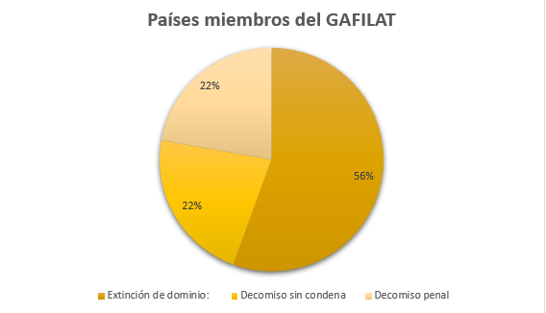
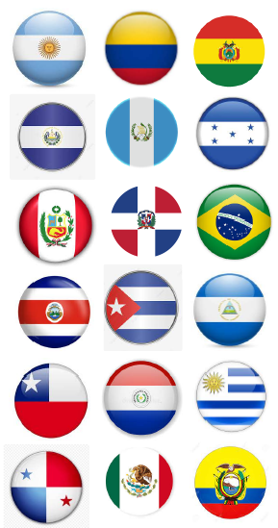

Slide 7
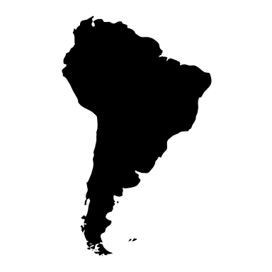
Model Law on Extinction of Ownership
Extinction of ownership is the predominant typology in 11 of the 18 Latin American countries and is presented as the Latin American legislator's response to the growing economic criminality.

Slide 8
Concept: According to Article 1 of the new version of the Model Law on Extinction of Ownership of 2022, the extinction of ownership is "a legal consequence that implies the transfer of ownership in favour of the State, of assets or property rights linked by origin or destination to illicit activities, without there being any consideration or compensation for the benefit of the owner.
The purpose of the extinguishment of ownership is not punitive as it does not aim to punish the offender nor does it rule on the aspects of his guilt.

Slide 9
Assets subject to Extinction of Ownership
Objects of the offence (objectum scaeleris),
Proceeds of crime (producta scaeleris),
Profits or gains from the proceeds of crime
Subrogated assets
Proceeds or effects (direct and indirect) of crime
property which has served, will serve or otherwise facilitate the commission of an offence (facilitation theory)
Instrumentalities of crime

Slide 10
Assets subject to Extinction of Ownership
introduces the concept of illicit enrichment as a presumption leading to non-conviction-based confiscation.
Assets representing illicit enrichment
non-conviction based confiscation of licit assets when they have been intermingled with illicit assets in order to conceal the true illicit origin of the latter.
Intermingled or contaminated assets
Assets written off for equivalent value
when the proceeds (direct or indirect benefits of crime) are not available for a reason that is generally attributable to the perpetrator.

Slide 11
CONCLUSIONS
International recovery of illicit assets in general, and recovery via non-conviction based forfeiture in particular, is one of the major challenges reported by GAFILAT countries. However, the fact that 10 of the 18 countries have adopted and enforced the asset forfeiture action is, in itself, an indicator of the rise of asset forfeiture laws in GAFILAT countries.
One of the challenges for GAFILAT countries at this stage of implementation of non-conviction based forfeiture laws is to make sufficient resources available to implement effective non-conviction based forfeiture systems, as well as to invest sufficient resources in the continuous training of justice operators from the different institutions involved in the judicial system.
It should be noted that the new FATF standards, through the amendment of Recommendation 38, seek to generalise judicial cooperation in non-conviction based forfeiture cases.
SHARED CHALLENGES BETWEEN THE EU/CELAC REGIONS IN THE DRUGS AREA
FACE-TO-FACE MEETING OF EU/CELAC DRUG AGENCIES IN BRUSSELS.

Slide 12
CONCLUSIONS
In this context, GAFILAT member countries give priority to the harmonisation of non-conviction based forfeiture models, in particular through the promotion of the Model Law on Confiscation of Ownership.
SHARED CHALLENGES BETWEEN THE EU/CELAC REGIONS IN THE DRUGS AREA
FACE-TO-FACE MEETING OF EU/CELAC DRUG AGENCIES IN BRUSSELS.

