Slide 1
INTPA Directorate G – Unit G5 Resilience, Peace and Security
Directorate-General for International Partnerships

Slide 2
The mandate
Resilience
Peace
Security
Ensures policy coherence on Fragility, Peace & Security related matters
Provides support to geographical programs (HQ and EU Delegations worldwide)
Ensures internal-external EU priorities interface vis-à-vis other EU services (DG HOME, FISMA, EEAS, FPI, ECHO, JRC) as well as Team Europe and other stakeholders on these matters
Notes:
The mission of INTPA G5 is to be a hub and centre of expertise for international cooperation regarding resilience, peace and security. We are a thematic Directorate and unit, in contras of A, B, C that are geographical.
These three key areas are tightly connected as part of one single continuum, which ranges from root causes of instability and fragility, conflict analysis, peacebuilding and mediation, up to EU action in capacity building and security sector reform.
The added value of the unit is thus to bring the various aspects of resilience, peace and security together, which should apply for both conceptual work, policy discussions, as well as for program design/implementation with INTPAs geographical directorates and with the EU delegations in a “co-creation” mode.
The three areas are complementary and closely interconnected, yet they are specific and thus require dedicated expertise and staff. To ensure that the expertise is provided in the most efficient way, the unit is organised in 3 dedicated sectors – on Resilience, Peace, and Security respectively, but works also as needed across the sectors.

Slide 3
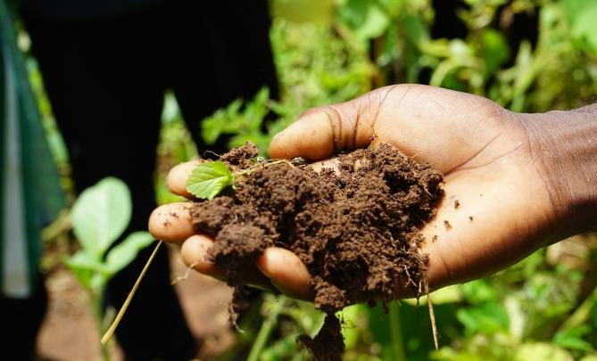
Promoting Peace & ensuring Resilience building by
Addressing fragility to demonstrate EU serves those most in need & the most vulnerable
How to stay engaged in complex settings, notably after unconstitutional or violent transitions? [e.g. Afghanistan, Sahel]
How to ensure EU’s tools & instruments are effective in fragile settings?
Mainstreaming the Humanitarian–Development–Peace (HDP) Nexus
The HDP Nexus approach aims at collaboration, coherence & complementarity between humanitarian, development & peace actors
It seeks to capitalize on the comparative advantages of each pillar to: a) reduce overall vulnerability & needs; b) strengthen risk management capacities; and c) address root causes of fragility & crisis
Mainstreaming Resilience building as a way to address fragility, including through the Rapid Response Pillar (RRP) Resilience, one of the thematic segments of NDICI
Ensuring EU programmes are conflict sensitive (i.e. ‘Do no harm’ principle; avoiding possible negative impacts of interventions & maximising opportunities for peace)
Notes:
G5 is also INTPA’s FOCAL POINT for:

Slide 4
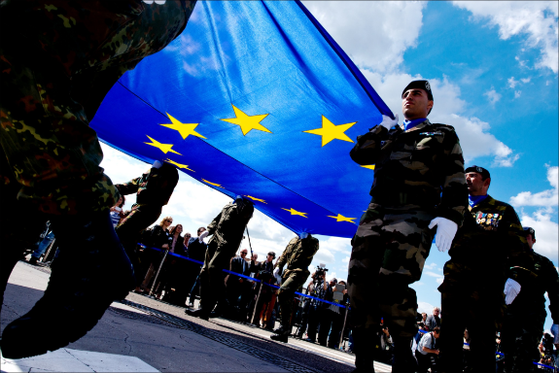
Ensuring Security for partner countries & the EU by
Providing support & coordination on Security Sector Reform [i.e. the work undertaken by governments to make their security institutions serve their citizens & provide people-centered security] of partner countries. Providing thematic support on Demobilisation, Disarmament & Reintegration of former combatants
Combating organised crime, including law enforcement cooperation in the context of the European Multi-disciplinary Platform against Criminal Threats (EMPACT)
Countering Terrorism and Preventing & Countering Violent Extremism, in ensuring coherence with established EU frameworks in this regard.
Supporting the resilience & security of Critical Infrastructure (linked to Global Gateway)
Ensuring support & coordination to combatting Illicit Financial Flows (IFFs). E.g. Team Europe Initiative that supports Africa in combating IFFs & Transnational Organized Crime
Notes:
G5 is also INTPA’s FOCAL POINT for:

