Slide 1
Uki Atkinson
Shared challenges among EU/CELAC regions in the drugs field Face-to-face meeting of EU/CELAC Drugs Agencies in Brussels.
Brussels, Belgium
8-10 October 2024

Slide 2
Initial Reaction to Early Warning Systems
2016 Introduction to EWS in (COPOLAD II launch in Kingston, Jamaica)
Low priority given Caribbean context – traditional drugs Alcohol, Cannabis, Tobacco, low prevalence of cocaine/crack cocaine use, minimal evidence of injection drug use
Change was at out doorstep
SHARED CHALLENGES AMONG EU/CELAC REGIONS IN THE DRUGS FIELD -
FACE-TO-FACE MEETING OF EU/CELAC DRUGS AGENCIES IN BRUSSELS.

Slide 3
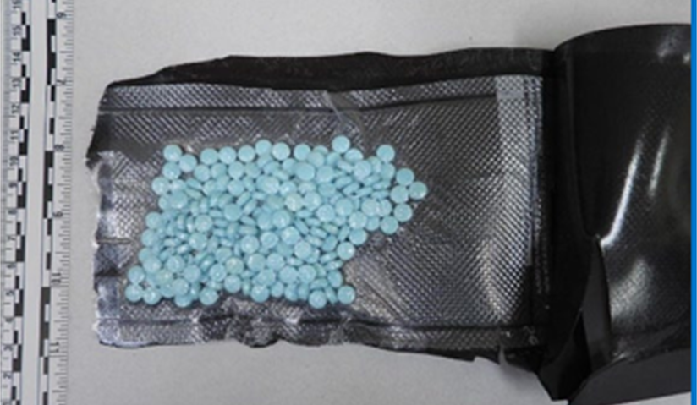
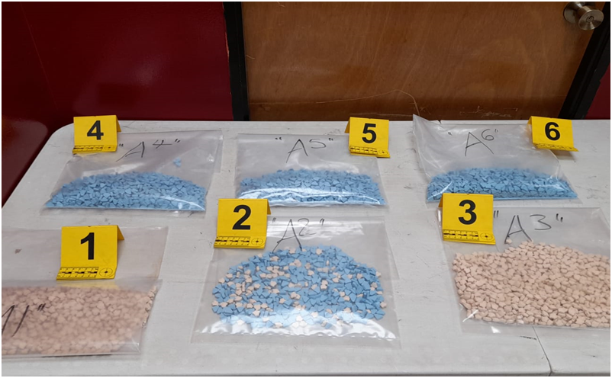
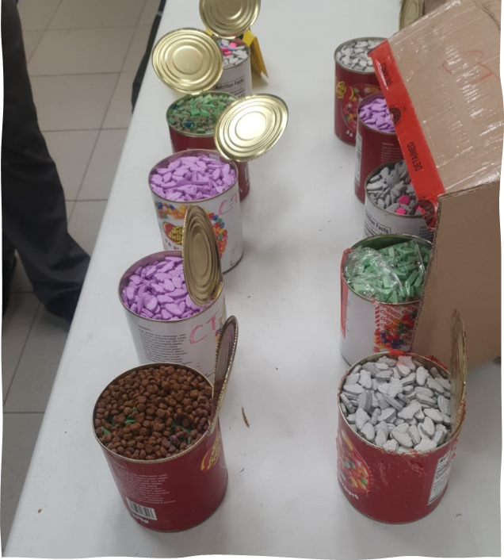
Contextual Changes in 2019 - 2021
Increased popularity of synthetic drugs and NPS among youth and young adults, in party scenes
Evidence of growing threats in most Caribbean countries
Early Warning Systems became an urgent need
Trinidad & Tobago, Barbados, Antigua, Suriname, Guyana, Jamaica & St. Lucia
SHARED CHALLENGES AMONG EU/CELAC REGIONS IN THE DRUGS FIELD -
FACE-TO-FACE MEETING OF EU/CELAC DRUGS AGENCIES IN BRUSSELS.

Slide 4
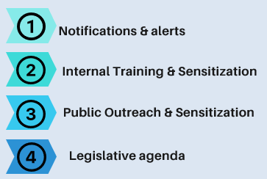
Jamaica’s EWS Journey
Jul-Sep 2024
Synthetic Drugs Study & Development of 4 EWS Sub-Committees (CICAD, NCDA & EWS Focal Points)
Dec 2024
Dissemination of Synthetic Drugs Study
(CICAD & NCDA)
Feb 2024
Sensitization on European context and model. Launch of the EWS& media engagement (EUDA/CICAD/COPOLAD/MOH/MNS/INL)
Feb - Jun 2024 Stakeholder analysis, Communication tools & priority setting
(NCDA & EWS Focal Points)
Oct-Nov 24
Internal capacity building: Foresight methodology & importance of Forensic Labs in EWS
(EUDA & CICAD)
Jun- Nov 2023 Sensitization on EWS and exposure to Latin American, Trinidad & Barbados Models (CICAD & COPOLAD)
Dec 2023 - Jan 2024 Selection of EWS Focal Points, Terms of Reference & Protocol Development
(NCDA & EWS Focal Points)

Slide 5
SOURCES OF INFRMATION by FOCAL POINTS
REPORT ON SEIZURES
• Narcotics Division
• Jamaica Customs Agency
• Jamaica Defense Force
• Jamaica Constabulary Force Marine Division
IDENTIFICATION OF USE/ROUTES
OF ADMINISTRATION FOR NPS
• National Drug Observatory
• National Drug Council
• Drug Treatment Institutions & Programmes
• Drug Prevention specialists
• Help Lines
• Support & Advisory
Services
• Qualified Informants
CHEMICAL ANALYSIS
OF SUBSTANCES
•Labs/Forensic/
Toxicological/Clinical
departments
• Supply Control Entities
REPORTS OF CLINICAL CASES OF
INTOXICATION/OVERDOSE OF NPS,
SUBSTANCES ALREADY KNOWN OR CONTAMINANTS
• Regional Health Authorities
• Emergency Physicians
• Help Lines
TOXICOLOGICAL INFORMATION ON
AUTOPSIES (INDIRECT MORTALITY)
•Labs/Forensic/
Toxicological/Clinical
Departments
REPORTS OF FORENSIC ANALYSIS OF DEATH CAUSED BY DRUG CONSUMPTION
• Labs/Forensic/Toxicological/Clinical
Departments

Slide 6
Thank You

