Slide 1
COPOLAD III
Abordaje de las vulnerabilidades
relacionadas con las drogas
en el territorio.
Addressing drug-related
vulnerabilities in the territory
Exchange on country developments - Territorialisation approach in action plans)
Port of Spain (Trinidad and Tobago)
March, 25th - 27th 2025
COPOLAD III is a consortium by:
Collaborating partners:

Slide 2
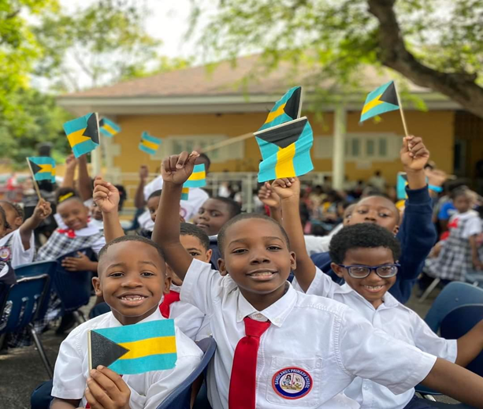
Assets Coming Together for Adolescents and Young Adult Health and Wellness
To establish and strengthen collaboration among community actors to prevent and reduce youth substance misuse and violence in the Fox Hill Community by building community capacity, providing training and technical assistance, and raising public awareness.
COPOLAD III es un consorcio formado por:
Socios colaboradores:

Slide 3
ACT NOW!!!!
ACT NOW!!! Is a comprehensive 8-month community-based initiative targeting multiple systems to reduce youth involvement in substance use, violence, and other problematic behaviors. The targets of the interventions are the families, the group of peers, the schools and the individual young people
COPOLAD III es un consorcio formado por:
Socios colaboradores:

Slide 4
ACT NOW!!!!
ACT NOW!!! aims to bring numerous stakeholders in the Fox Hill community together as a prevention and health coalition. These include governmental officials, young people and parents, those involved in law enforcement, schools, public health officials, Civil Society, NGO’s serving local young people and families, the faith community, the business community and other service providers and the residents to build a healthy and safe environment for young people and their families.
COPOLAD III es un consorcio formado por:
Socios colaboradores:

Slide 5
ACT NOW!!! The Future
LIFT EVERY VOICE – Community Mapping
National Violence Policy
Strengthening Families
ACT Now in Other Communities
Students Against Destructive Decisions
COPOLAD III es un consorcio formado por:
Socios colaboradores:

Slide 6
Opportunities/ Challenges
Community Coalition
Training in Policy Development
Financial and Human Resources
Community Forums / Community Fun Days
Basketball Tournament
Students Against Destructive Decisions Clubs
Summer School Programs
Parent Education Traininng
Neibourhood Community Clean up
COPOLAD III es un consorcio formado por:
Socios colaboradores:

