Slide 1
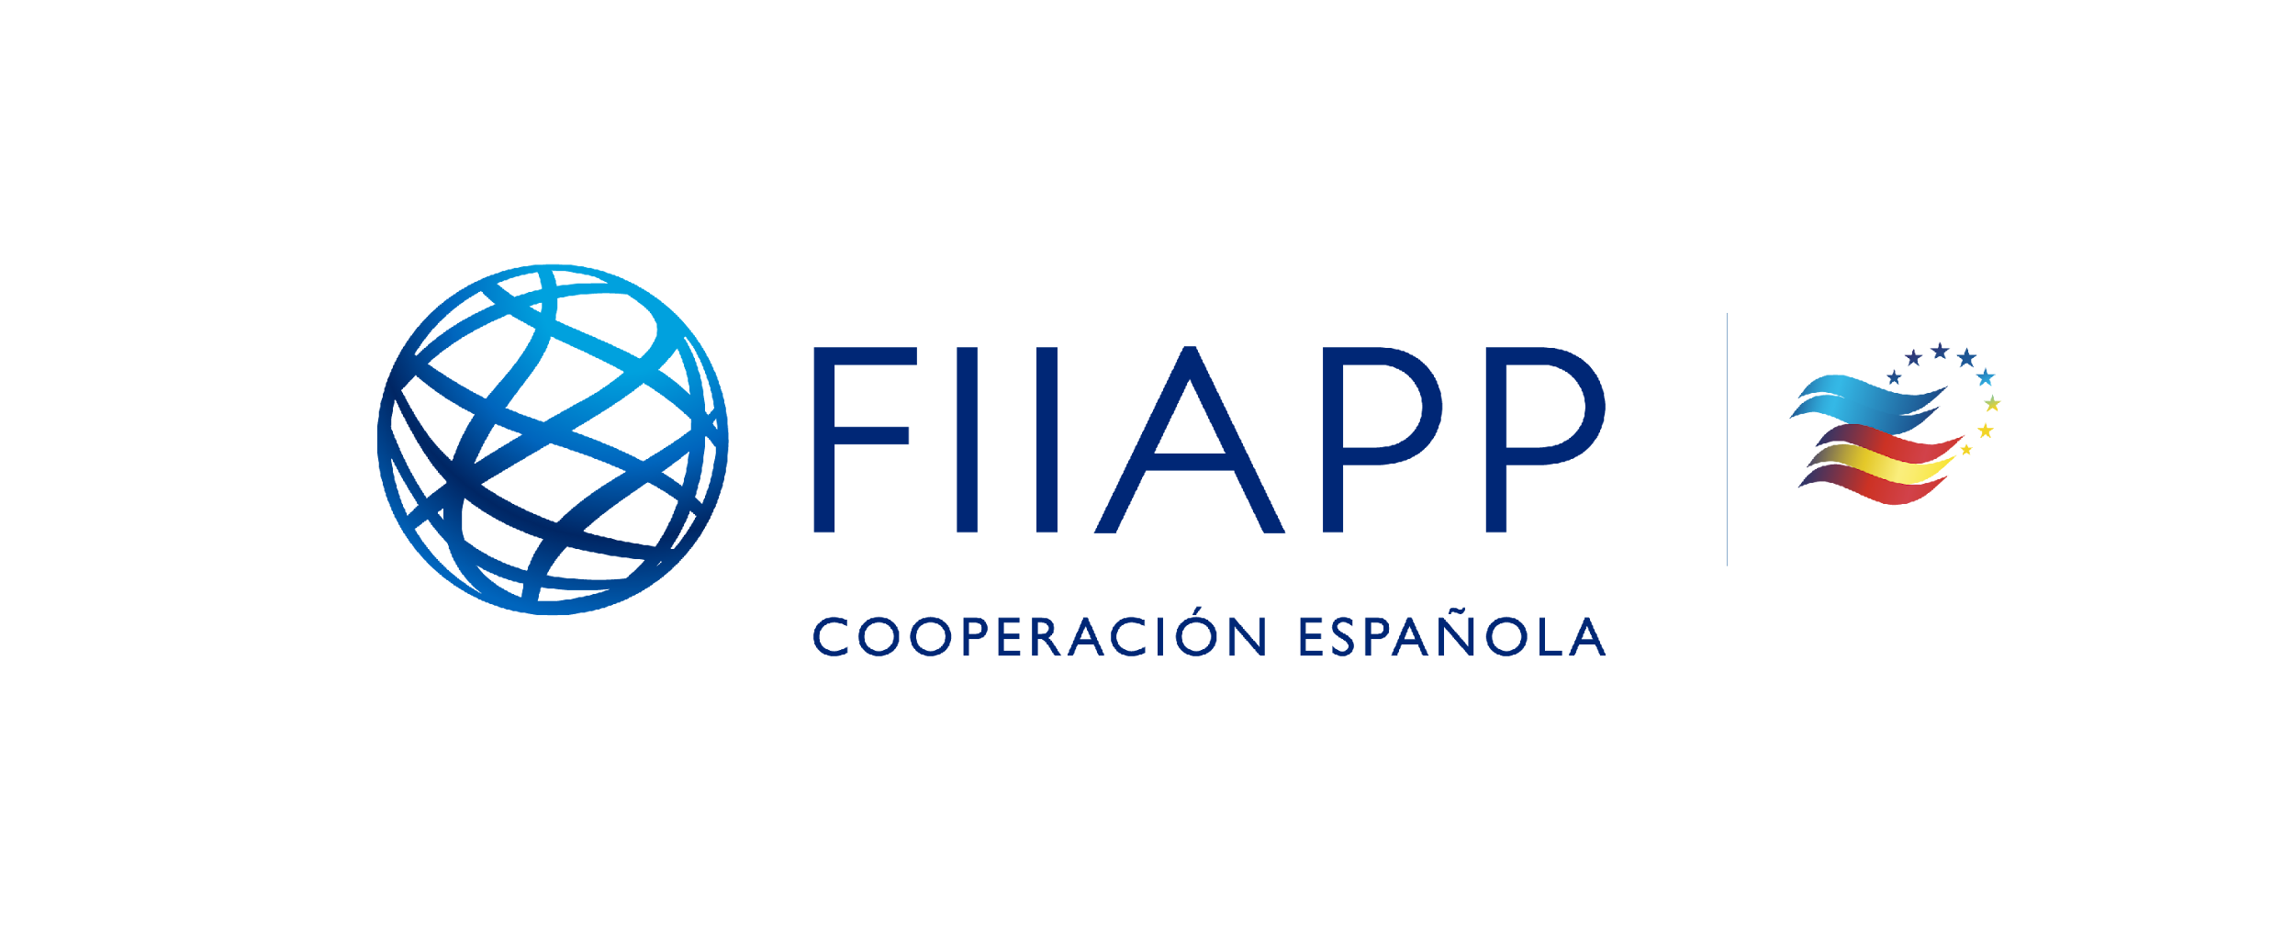
COPOLAD III
Addressing drug-related vulnerabilities in the territory.
Jamaica Country Report: Redirection- Guiding Communities Towards Empowerment
Representatives:
Trisha Thompson-McCarthy – Director of Programme Development-NCDA
Natoya James-Case Management Coordinator (Local Advisor)
Puerto España (Trinidad y Tobago)
March, 25th - 27th 2025
COPOLAD III es un consorcio formado por:
Socios colaboradores:

Slide 2
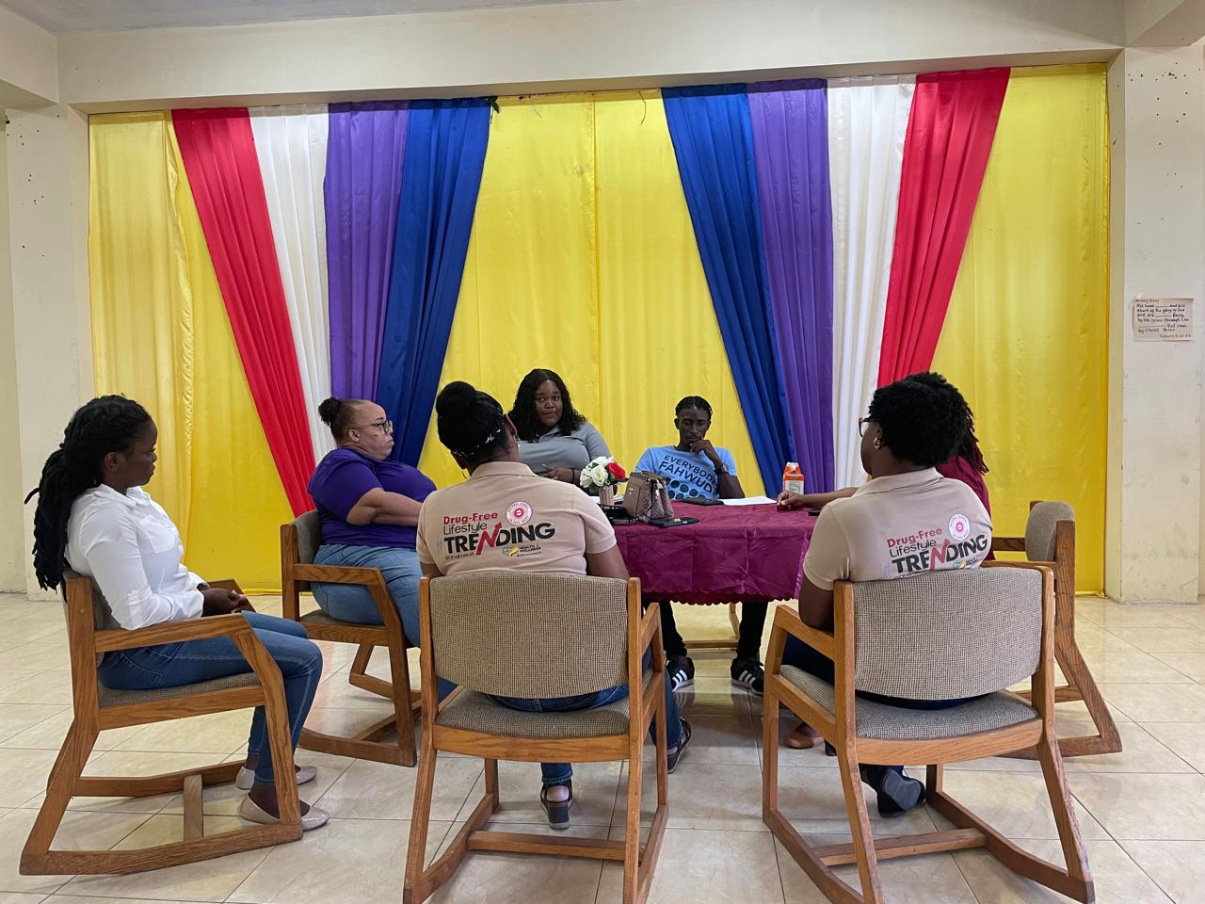
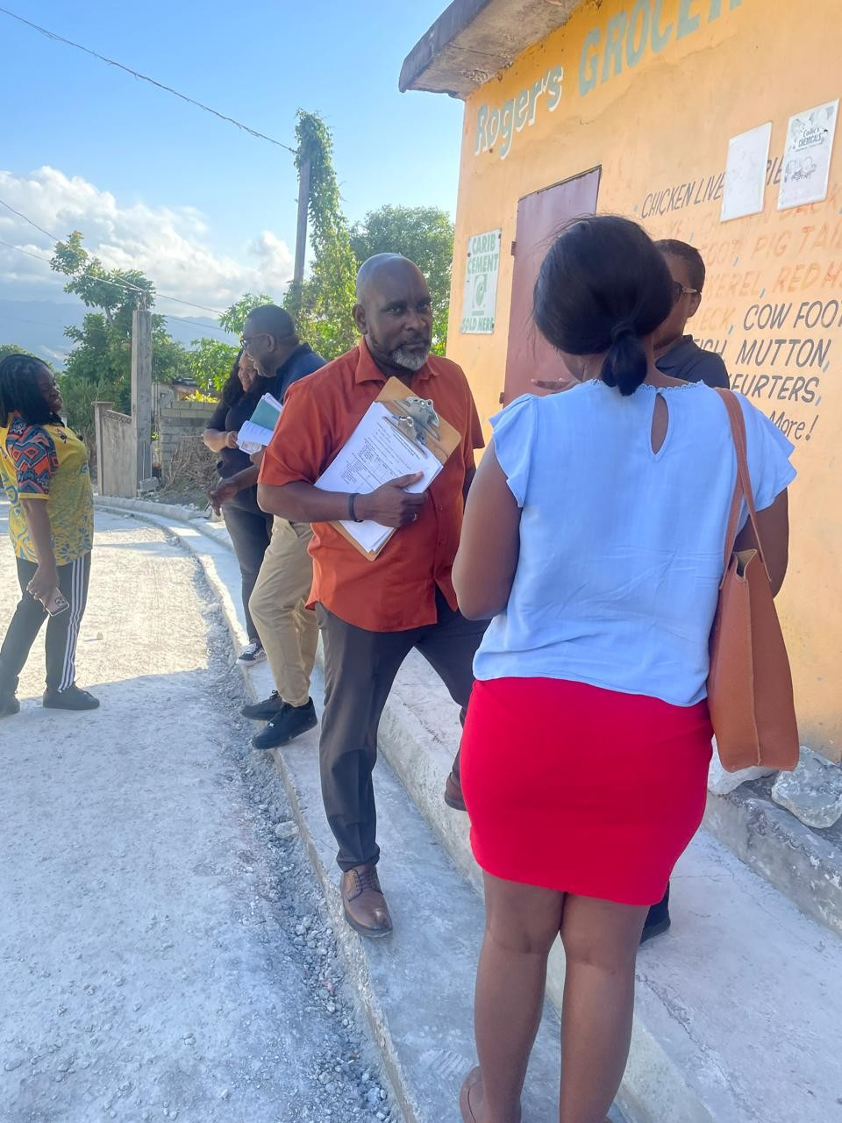
Redirection- Guiding Communities Towards Empowerment
Proposal and Justification
Redirection –Guiding Communities Towards Empowerment
A programme intending to reduce prevalence and risk factors of Drug use among boys 12-17 yrs old in the Salt Spring Community of Montego Bay St. James
COPOLAD III es un consorcio formado por:
Socios colaboradores:

Slide 3
The Problem
Proposal
The National Council on Drug Abuse a Department under the Ministry of Health and Wellness proposes to reduce the prevalence and risk factors of drug use among boys aged 12-17 in the violence prone community of Salt Spring St. James.
Through:
Programmatic interventions at the individual, family, and community levels
Strengthening the capacity of parents, Community actors ( Bartenders, shopkeepers) and their support networks through targeted education, awareness, and life skills training resulting in community empowerment.
Socios colaboradores:

Slide 4
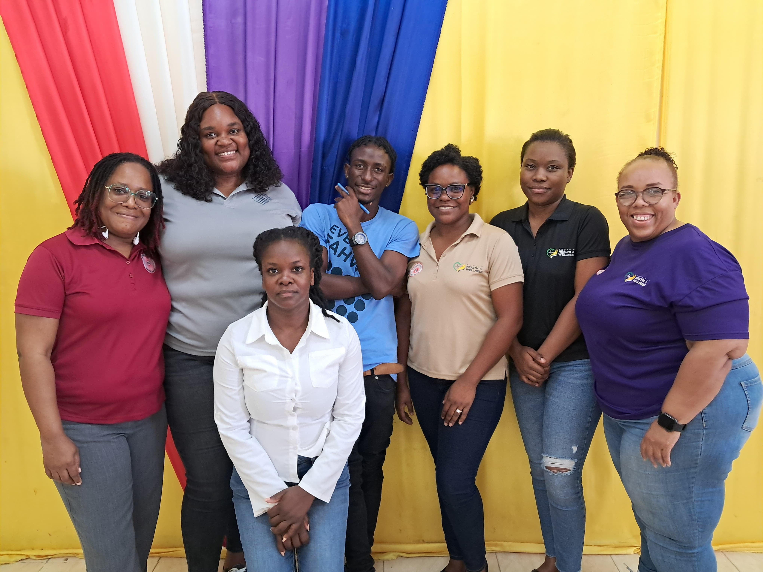
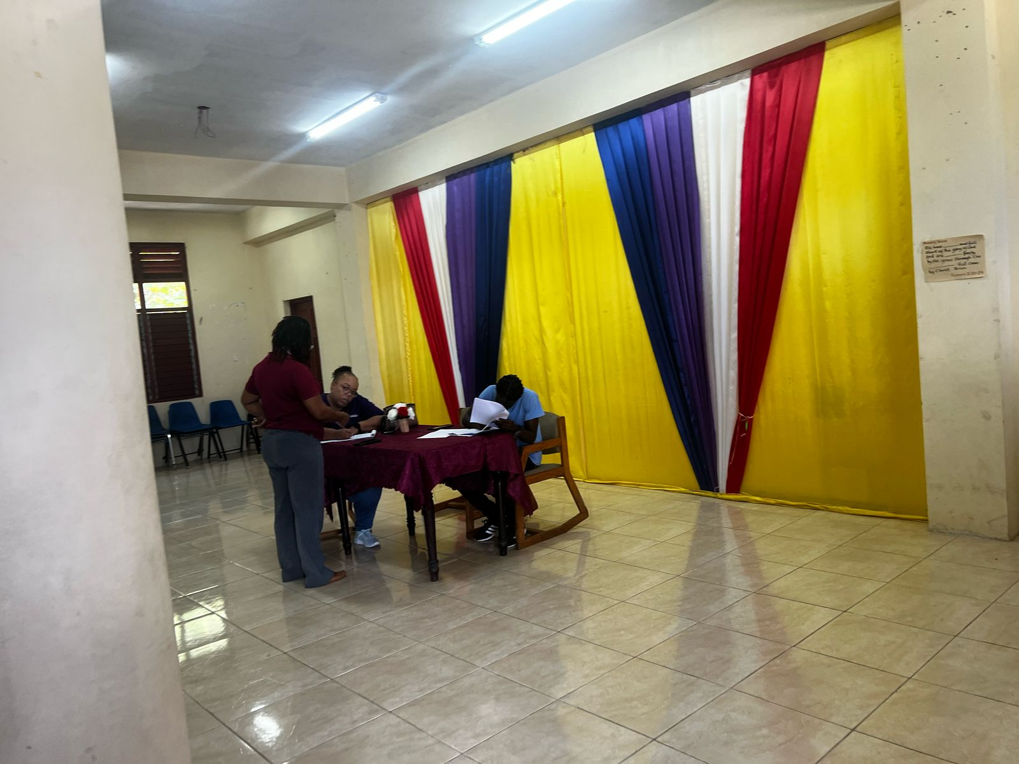
Actors Participating In The Process
A multi-stakeholder approach involving:
Families,
Schools,
Law enforcement, (Community Safety and Security Branch
Religious institutions,
Healthcare providers,
Policymakers,
NGOs,
Community leaders
These actors are essential for the success of drug prevention efforts in Salt Spring. Engaging these actors ensures a comprehensive, community-driven solution that empowers youth and strengthens social structures to reduce substance use risks
COPOLAD III es un consorcio formado por:
Socios colaboradores:

Slide 5
Territorialization: Multi-level Approach
Territorialization: Multi-level Approach
Individual Level: Youth need targeted education and life skills training to build resilience, self-confidence, and decision-making abilities that help them resist negative peer influences.
National Institute on Drug Abuse. (2020
Family Level: Parents and caregivers require training in effective parenting strategies, communication, and emotional support skills to provide guidance and positive role models.
Hawkins, J. D., Catalano, R. F., & Miller, J. Y. (1992)
.
Community-Level Intervention: Empowering community actors (such as teachers, local leaders, law enforcement, and social workers) ensures a holistic approach to drug prevention, promoting safer environments and stronger support networks for at-risk youth.
Hawkins, J. D., & Catalano, R. F. (2005).
Kellam, S. G., Wang, W., Mackenzie, A. K., & Brown, C. H. (2012).
Notes:
Individual Level: psychosocial sessions where participants will be engaged with life-skills and resilience building sessions, positive recreational sessions (Partners).
Family Level: caregivers will be engaged through a family empowerment programme called Operation Lighthouse. This program engages children and parents simultaneously and then collectively.
Community Level: engagement of Shop and Barkeepers in Substance Education- drug identification and classifications, impact of drugs, the Law as it relates to sale and possession. This community engagement is intended to increase awareness of risk which should result in a responsible use, limit access to minors and harm reduction for adult users

Slide 6
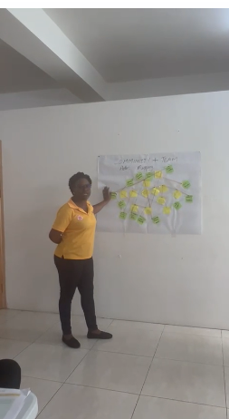
How to Proceed In The Future
The National Council on Drug Abuse (NCDA)intends to expand the territorialization initiative beyond Salt Spring through its Targeted Community Intervention programme
The National Council on Drug Abuse currently implements a programme called Targeted Community Interventions (TCI):
This is geared at engaging communities in an effort to build healthy communities as protective factors for drug use.
This will adopt the territorialization framework utilized in Salt Spring to meet the needs of other communities Nationally through our (NCDA’s) Parish officers
COPOLAD III es un consorcio formado por:
Socios colaboradores:

Slide 7
Challenges and Opportunities
Challenges
Opportunities
High Crime and Violence Rates
Community readiness
Resources /Funding
Community Trust/ previous Trauma
Access to Community resources
Willing Stakeholders to participate in activities
COPOLAD III es un consorcio formado por:
Socios colaboradores:

