Slide 1
"International cooperation: communication mechanisms and exchange of intelligence"
27 July 2023

Slide 2
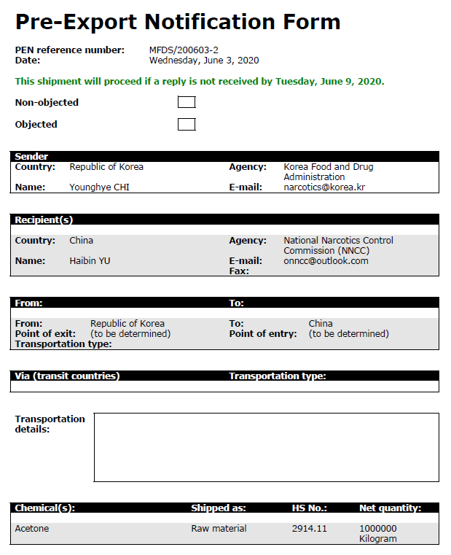
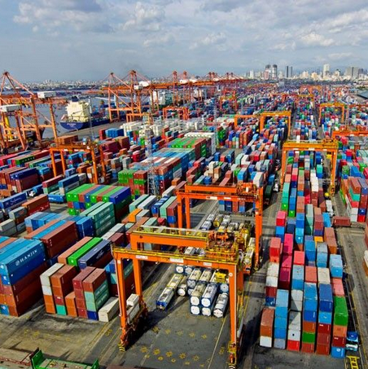
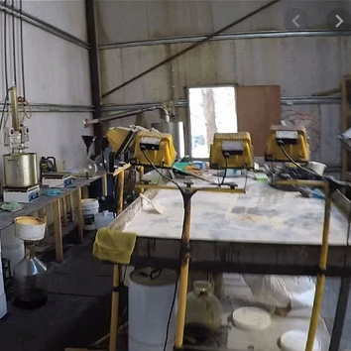
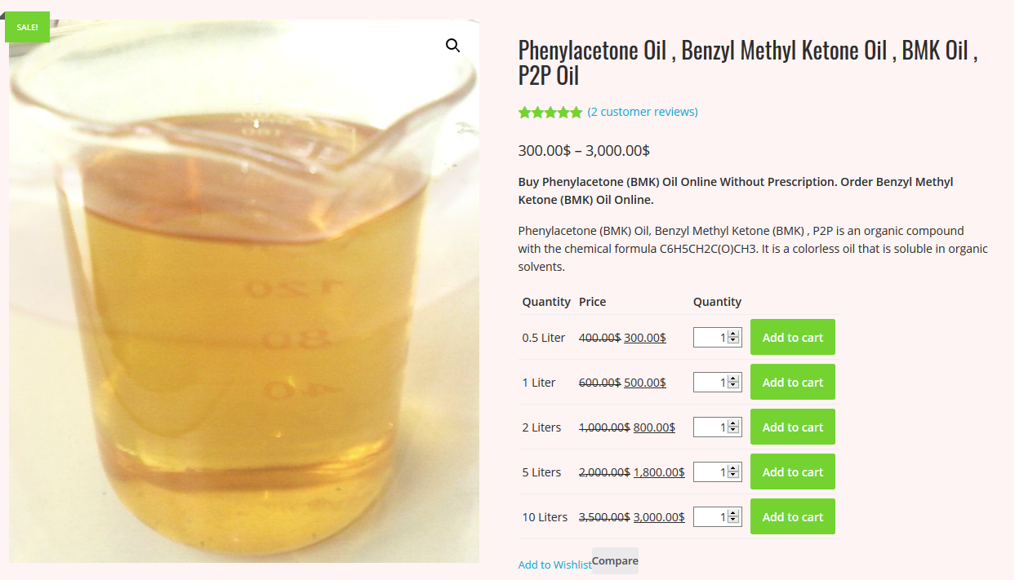
Strategies for addressing precursors (and pre-precursors) diversion and trafficking
Tentative intervention points
Orders and Inquiries
(diversion attempts)
International licit trade & distribution
(diversion attempts)
Transportation (trafficking)
Clandestine lab
(illicit use)
Preventive measures
Preferred point of intervention
Voluntary reporting of suspicious circumstances by trading companies and carriers
Preventive measures
Preferred point of intervention
Routine customs checks
Risk profiling
Targeted operations
Voluntary reporting of suspicious circumstances by commercial carriers
Backtracking investigations
Notes:
On mucho gusto .

Slide 3
Topics:
Mandatory reporting of seizures of precursors on form D
PEN Online and PEN Online Light
PICS
Legal provisions for seizure of controlled substances if there is evidence of their intended use in the illicit manufacture of drugs (1988 Convetion, Art. 9b)

Slide 4
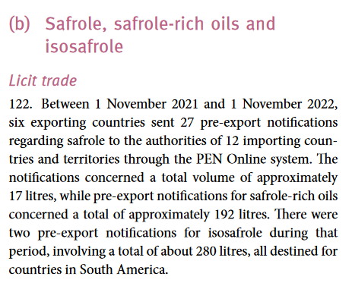
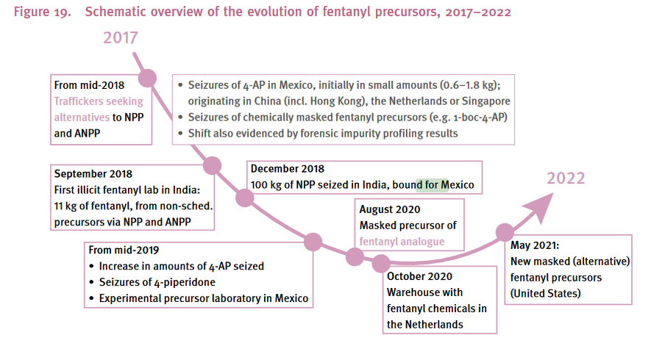
Communication of seizures, trafficking trends and licit trade patters

Slide 5
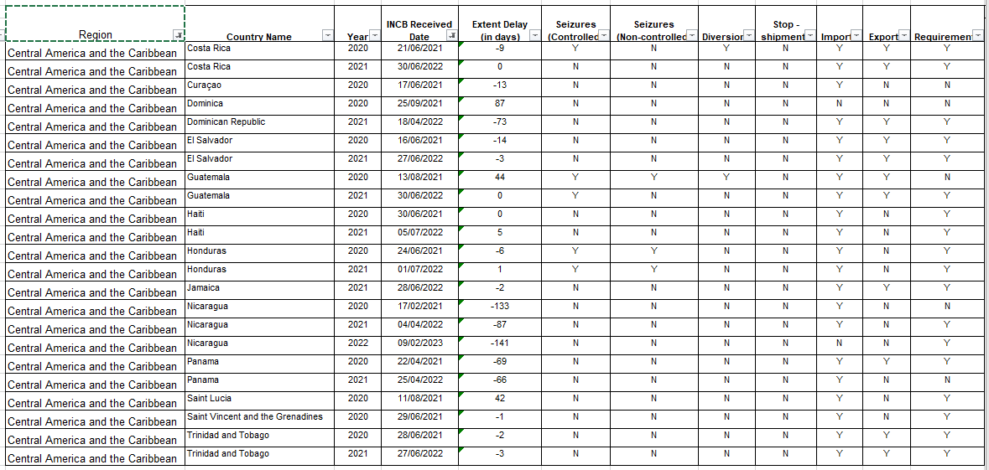
Mandatory reporting on form D 2020-2023
Deadline for form D 2022 submission: end-June 2023

Slide 6
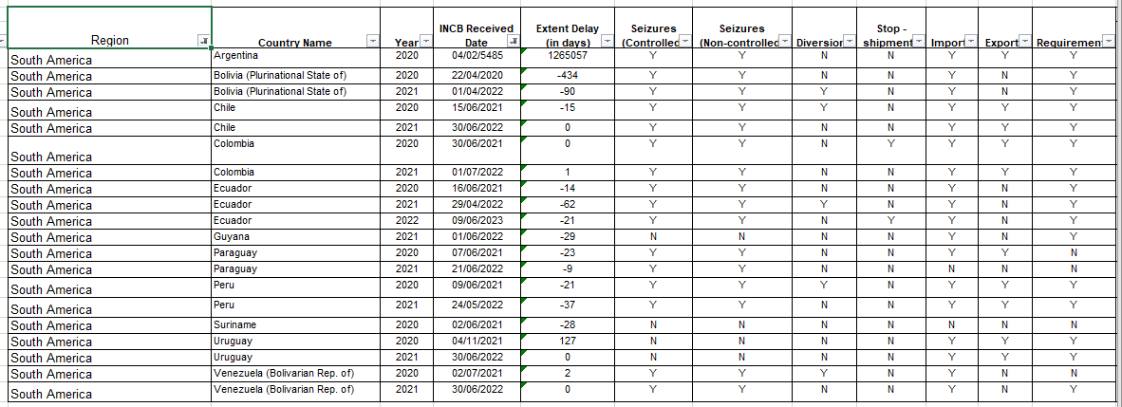
Mandatory reporting on form D 2020-2023
Deadline for form D 2022 submission: end-June 2023

Slide 7
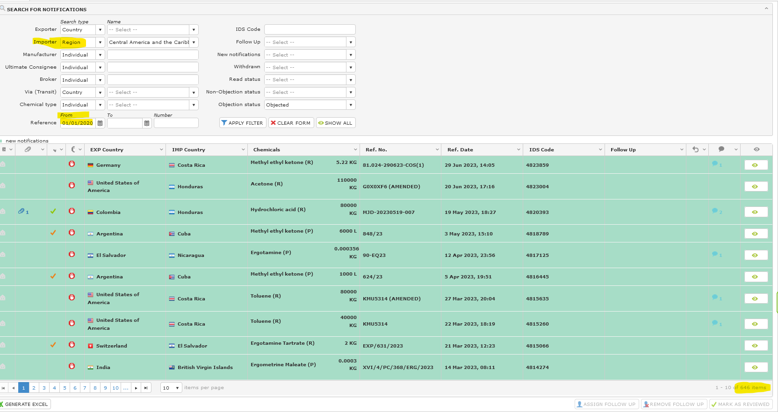
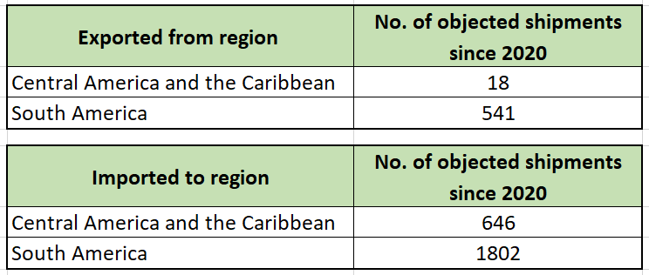
Investigations into legitimacy of pre-notified shipments objected to by importing countries in CA and Caribbean

Slide 8
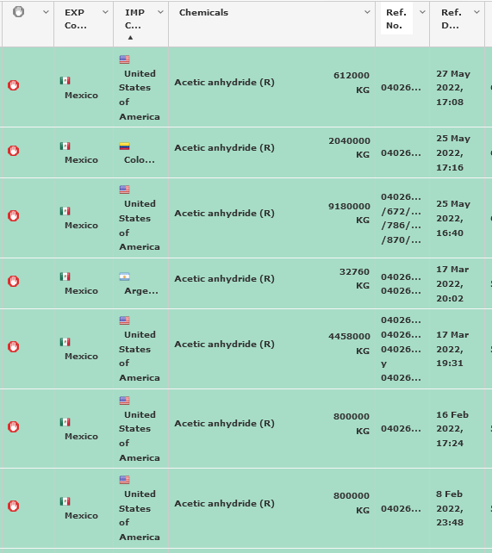
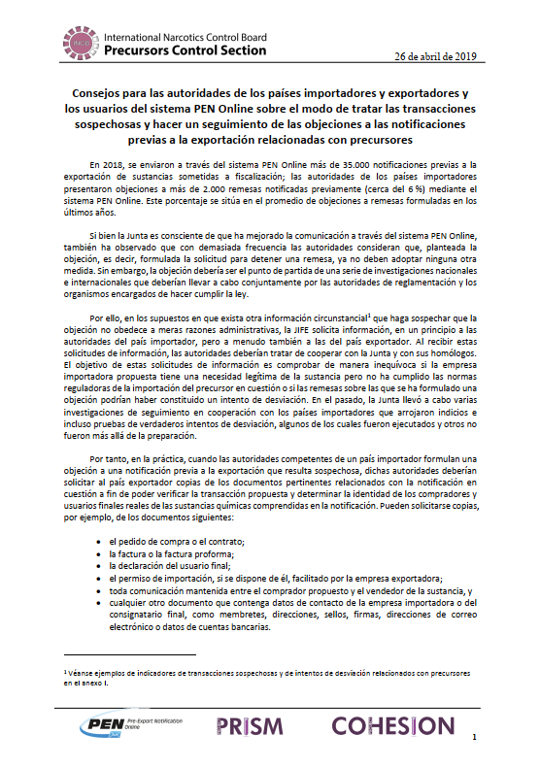
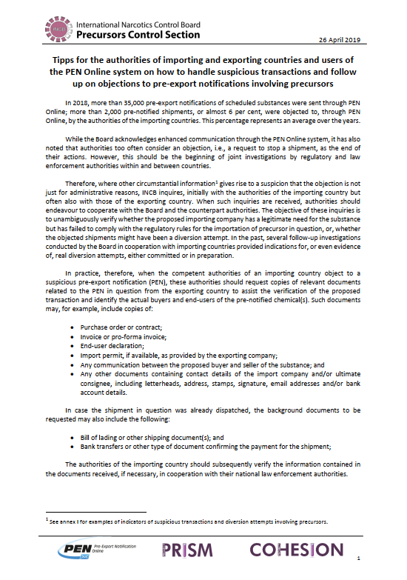
Investigations into legitimacy of shipments objected through PEN Online

Slide 9
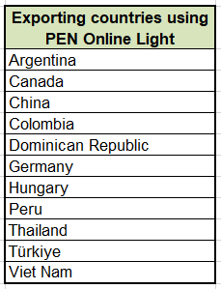
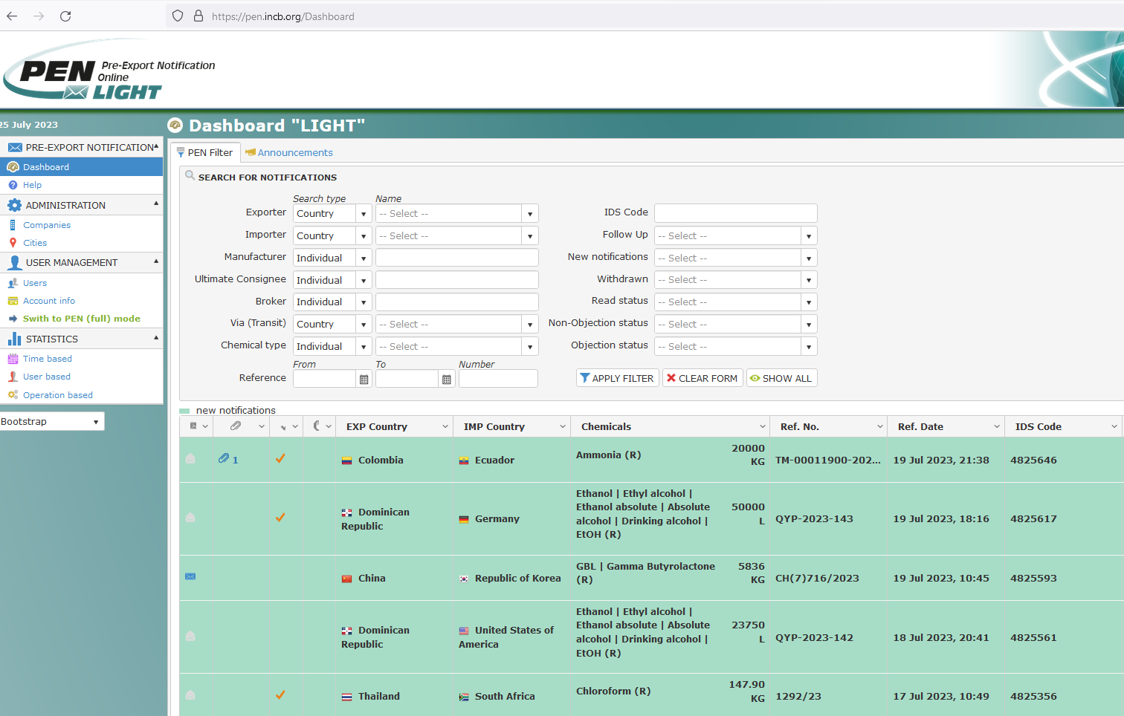
Use of PEN Online Light by countries in CA and the Caribbean

Slide 10
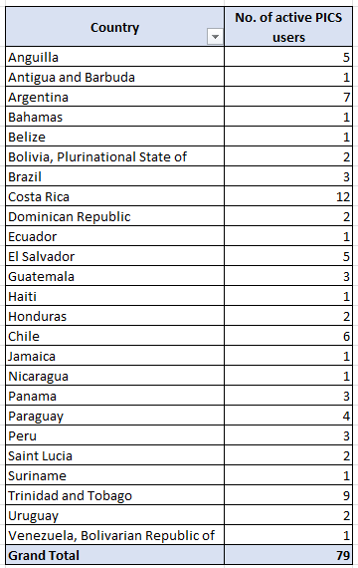
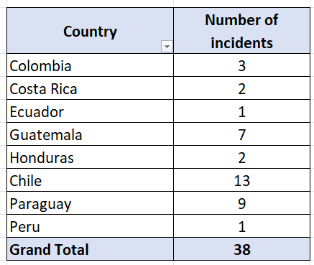
2020 - 2023

Slide 11
Use of PICS

Slide 12
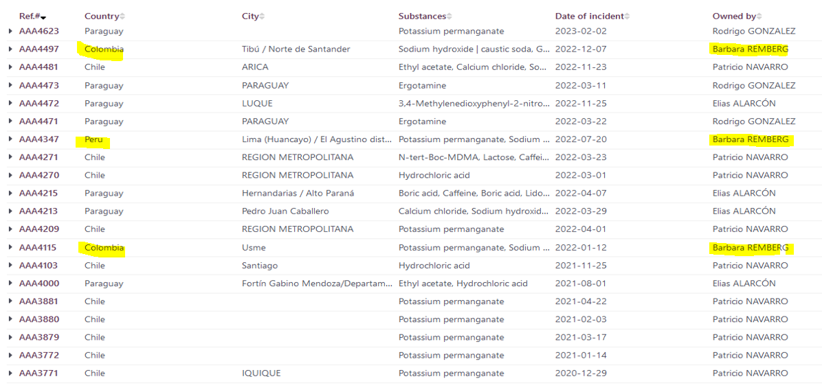
Communication of seizures by countries through PICS

Slide 13
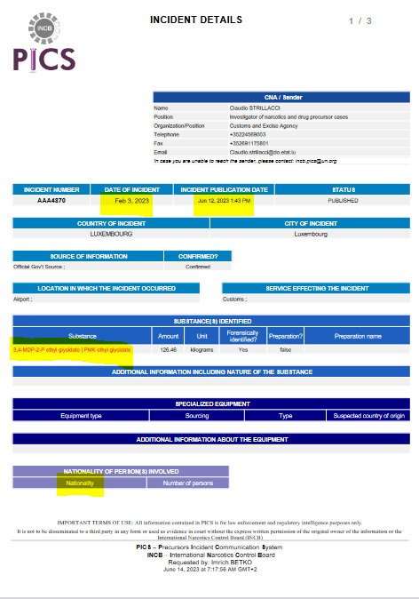
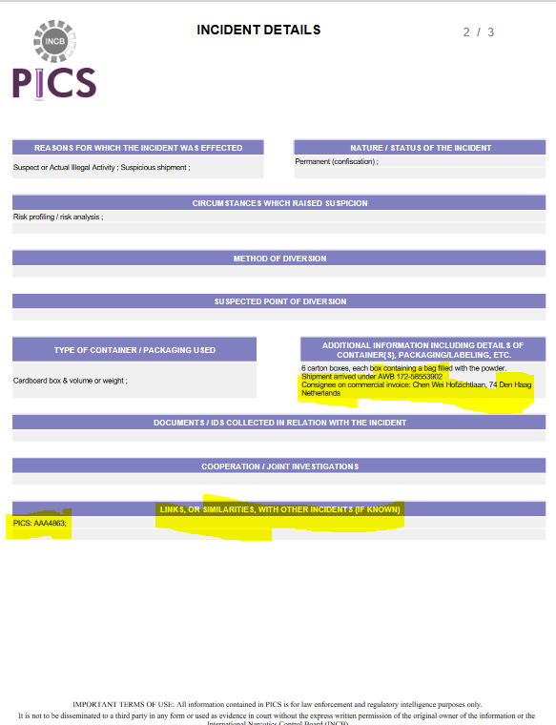
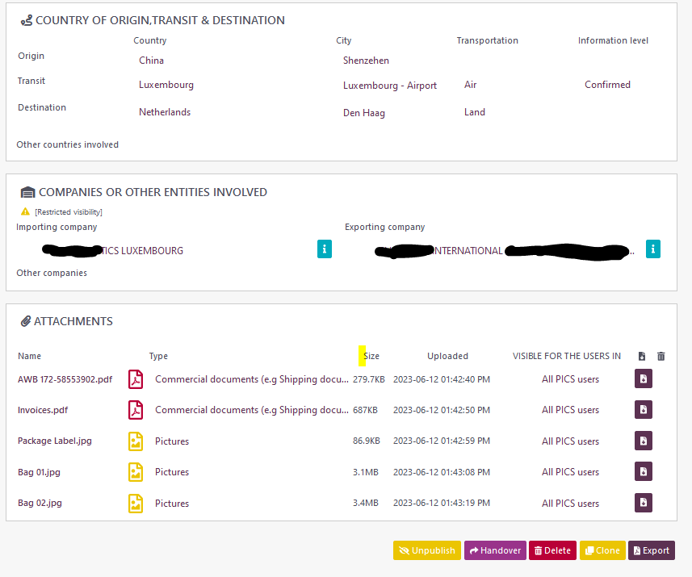
Benefits and challenges of sharing of information on seizures through the existing platforms (PICS)

Slide 14
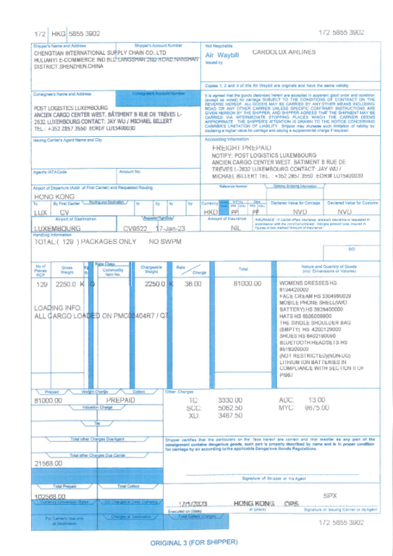
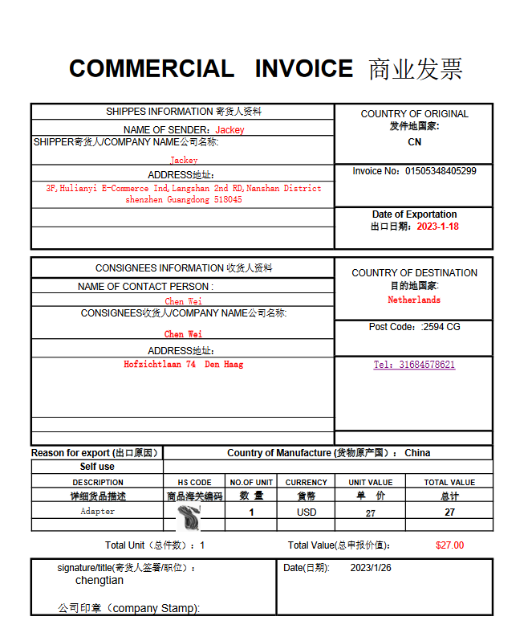
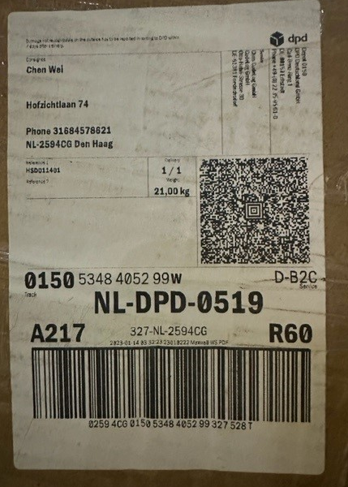
Benefits and challenges of sharing of information on seizures through the existing platforms (PICS)
AWB
Invoice
Pictures / labels

Slide 15
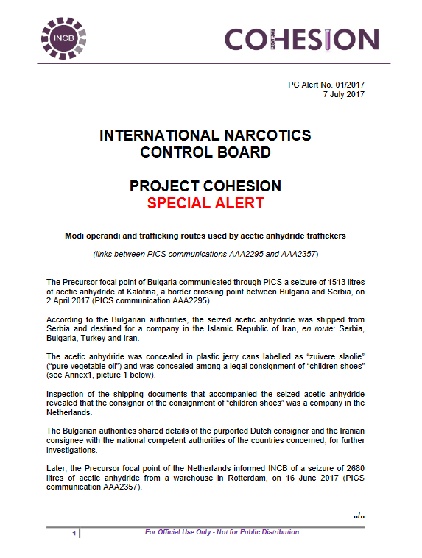
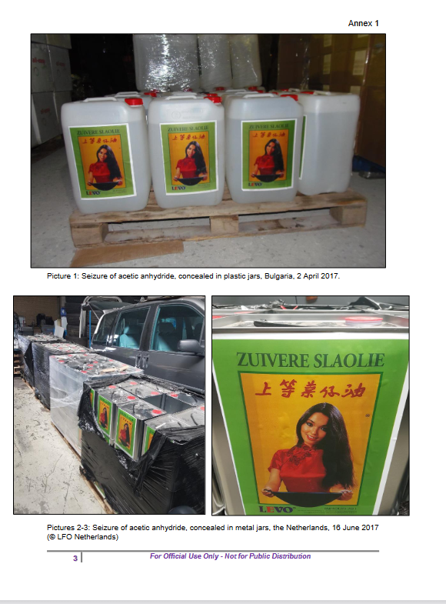
Benefits and challenges of sharing of information on seizures through PICS

Slide 16
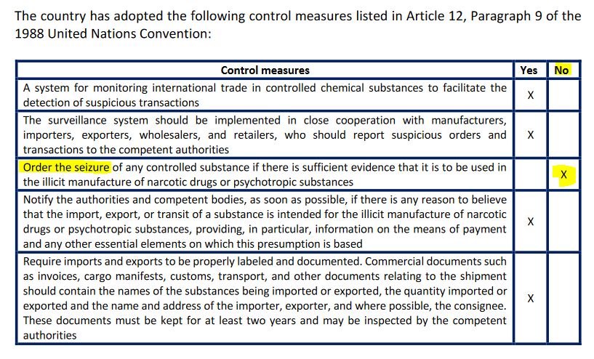
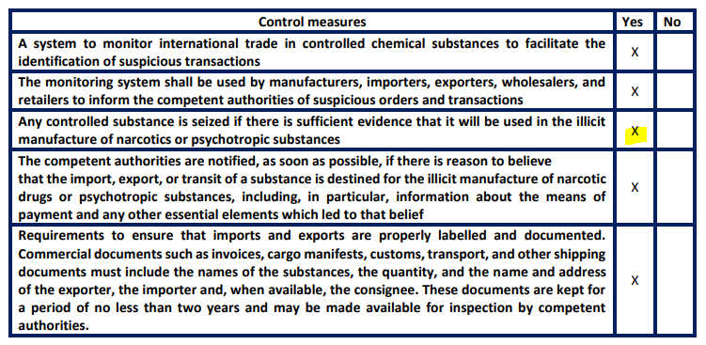
Mexico
Guatemala

Slide 17
Thank you for your attention
Imrich Betko (Mr.) Drug Control Officer Precursors Control Section Secretariat of the International Narcotics Control Board (INCB) United Nations Office on Drugs and Crime PO Box 500 1400 Vienna Austria Tel.: (43-1) 26060-4166 Fax: (43-1) 26060-5930 Email: imrich.betko@un.org

