Slide 1




The European Union Drugs agency – perspectives on risk and harm reduction policies, promotion of public health and inclusion.
COPOLAD III MEETING
High-Level Seminar of EU and CELAC National Drug Agencies on Common Challenges in the Drug Sector
Marica Ferri, PhD
Head of Sector Health and Social Responses
EUDA

Slide 2
Where are we
Today’s Drugs Field: A New Level of Complexity
New substances
Diversified trafficking routes and technologies;
New actors and networks dynamics;
Changing patterns of use
Different groups, different needs
What This Means: Fragmented responses no longer work
Boundaries between prevention, treatment, harm reduction, reintegration have blurred;
We must build integrated, multidisciplinary expertise
And connect evidence, policy and practice in real time

Slide 3
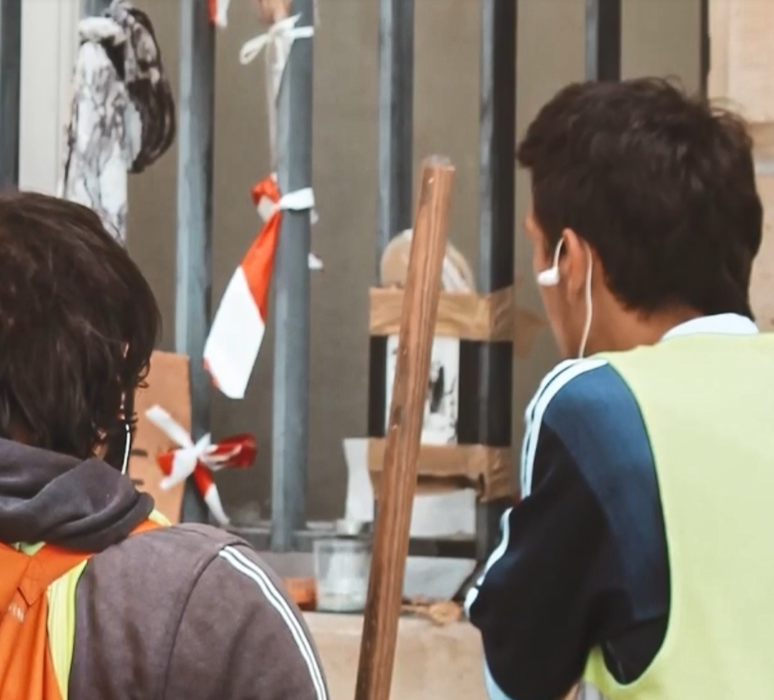
Vision for Health and Social Responses (HSR)
We aim to deliver people-centred solutions, recognising that individuals naturally move across needs — from prevention to harm reduction, treatment, and social reintegration.
HSR is a continuum, not a set of isolated interventions. It’s a whole-of-society response that includes health, security, education, and even culture and entertainment.
To support this, we see HSR as a package of interventions and mutual referring and common learning.
Our sector acts as a hub — connecting people, practices, and systems to meet real-world needs.

Slide 4

Who We Serve
Professionals inside and outside the EUDA (evidence, research-synthesis, best and innovative practices and training):
Community leaders and decision makers (evidence for action, quality standards, training and implementation science)
Policy makers: (training, knowledge exchanges, briefing, discussion fora);
Professionals and Scholars: (quality standards, guidelines, training, winter and summer schools);
NGOs: (learning experience and online conversations)
People who use substances and CSO, partnership engagement in training, discussions and publications.
General public: webinars, survey consultations, publications;
We are a service with a 360-degree client base.
Who are our clients/partners/stakeholders?

Slide 5









Mission and core areas of work
Prevention and health promotion
Guidance on preventing drug use and promoting safer communities.
Treatment and reintegration
Evidence synthesis for effective care, recovery, and social reintegration.
Harm reduction
Supports interventions to reduce the adverse consequences of drug use.
Training and capacity building
Webinars, expert exchange, and professional Knowledge sharing
Reports, digital publications, and expert insights.
International cooperation
Support for global health efforts and EU strategies.
Social Reintegration
Providing opportunities for all individuals to fully realise their potential and contribute to society, regardless of their starting point or life circumstances.
Implementation Support:
Support in setting objectives and implementing improvement for quality of interventions and settings.
Mission:
To support evidence-based responses to drug-related challenges by providing timely, high-quality scientific knowledge, sharing best practices, and offering implementation support across the EU and beyond.
Detailed key areas of work and main contributions are presented in the following slides.

Slide 6


Prevention, crime prevention and health promotion
Harm reduction
Supports data collection on the availability and effectiveness of prevention interventions.
Publishes European evidence reviews and summaries on prevention.
Develops quality standards, tools, and a registry of evaluated programmes.
Delivers training via the European Prevention Curriculum (EUPC), trainer support, and e-learning.
Targets key settings and populations, including schools, workplaces, families, young people, and vulnerable groups.
Focuses on reducing harms of drug use, regardless of quitting use.
Synthesises evidence and maps knowledge gaps on harm reduction interventions.
Develops relevant guidelines and ensures service quality.
Supports improved data collection and expert input.
Evaluates harm reduction interventions such as Drug Consumption Rooms.
Addresses specific topics, including harm reduction for cannabis use.

Slide 7

Treatment
Social reintegration
Synthesises evidence and maps treatment gaps on health services to individuals who use drugs, also with co-morbidities, including medical treatment, psychological counselling, and support for social reintegration.
Develops guidelines and treatment quality standards and quality assurance.
Supports quality assurance through EU-QUALITY mechanisms (European Quality Standards).
Focuses on treatment of psychostimulants and synthetic opioids.
Monitors outcomes and explores digital interventions.
Social Reintegration
Enabling people to reclaim a meaningful role in society, recognising that reintegration often overlaps with treatment and harm reduction.
Early access to housing, education, and employment through low-threshold services (e.g. job coaching in harm reduction settings).
Integrated planning that includes social goals in treatment (e.g. community engagement, peer support).
Flexible, person-centred pathways to participation (e.g. creative grants, volunteering, supported work).

Slide 8

Training, capacity building and
webinars
Digital publications, health in international cooperation and artificial intelligence
Collaborates with the European Prevention Curriculum (EUPC) to develop and promote best practice in prevention training.
Curates PLATO, an e-learning platform and virtual community of practice for drug-related training and knowledge sharing.
Hosts monthly open webinars on health and social responses to current drug-related topics.
Delivers top-level training sessions for ministry officials and policymakers.
Organises European Drug Summer and Winter Schools on imminent drug-related issues for professionals and students.
Supports digital publications by providing accessible and reliable health and social response resources.
Supports international cooperation through translation, adaptation, and competence development in partner countries.
Supports the application of AI for efficient evidence retrieval and synthesis in health.
Supports sharing and promotion of best practices via a dedicated online portal.

Slide 9
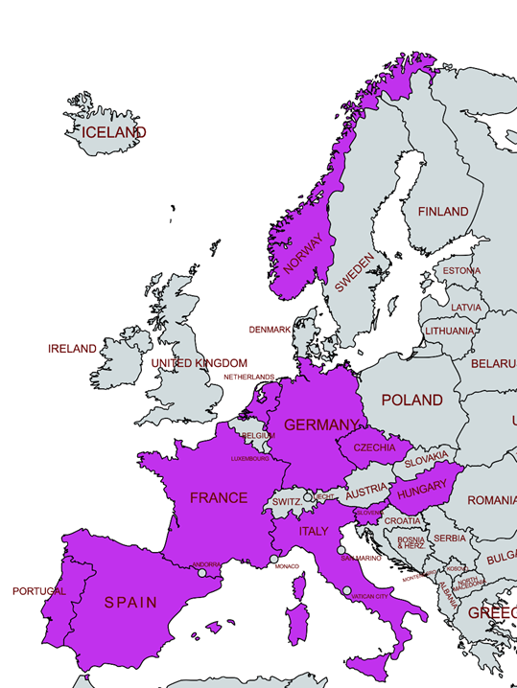
EU-COMP collection of curricula for professionals training
Needs assessment:
Focus group
N = 25
10 countries
Experts in prevention work, harm reduction or substance use treatment, peer support work.
In-depth perspective on:
  Types of professionals & services
  Types of training, required trainings, main providers, inventories
  Barriers & facilitators to training access
  Training needs & lacking competencies
  QS for training or how it is organized
  EUDA & platform role

Slide 10
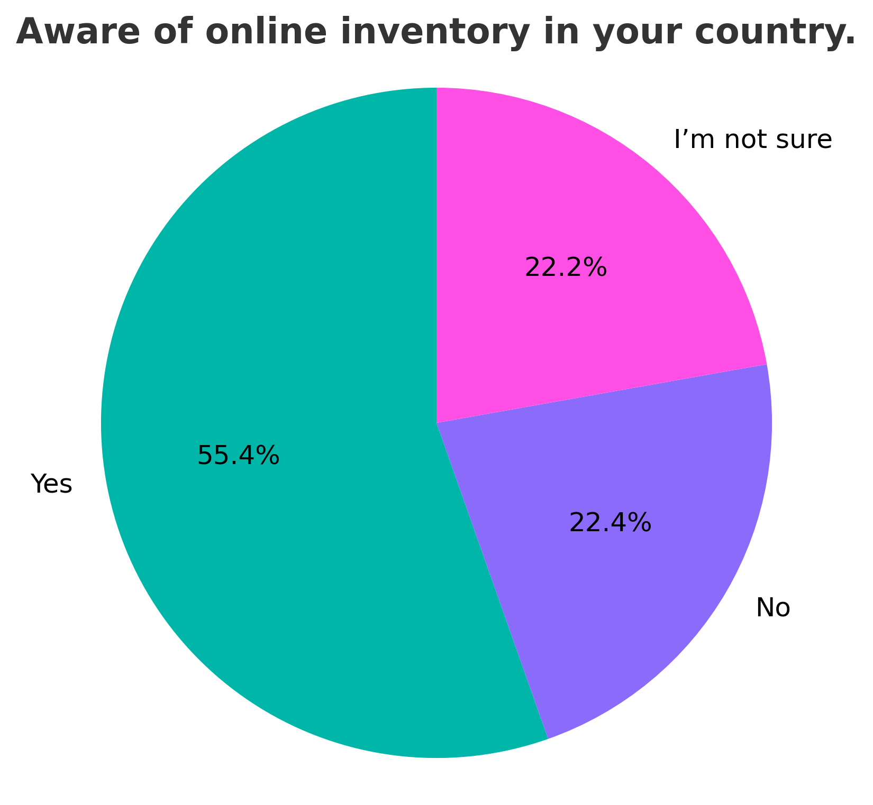
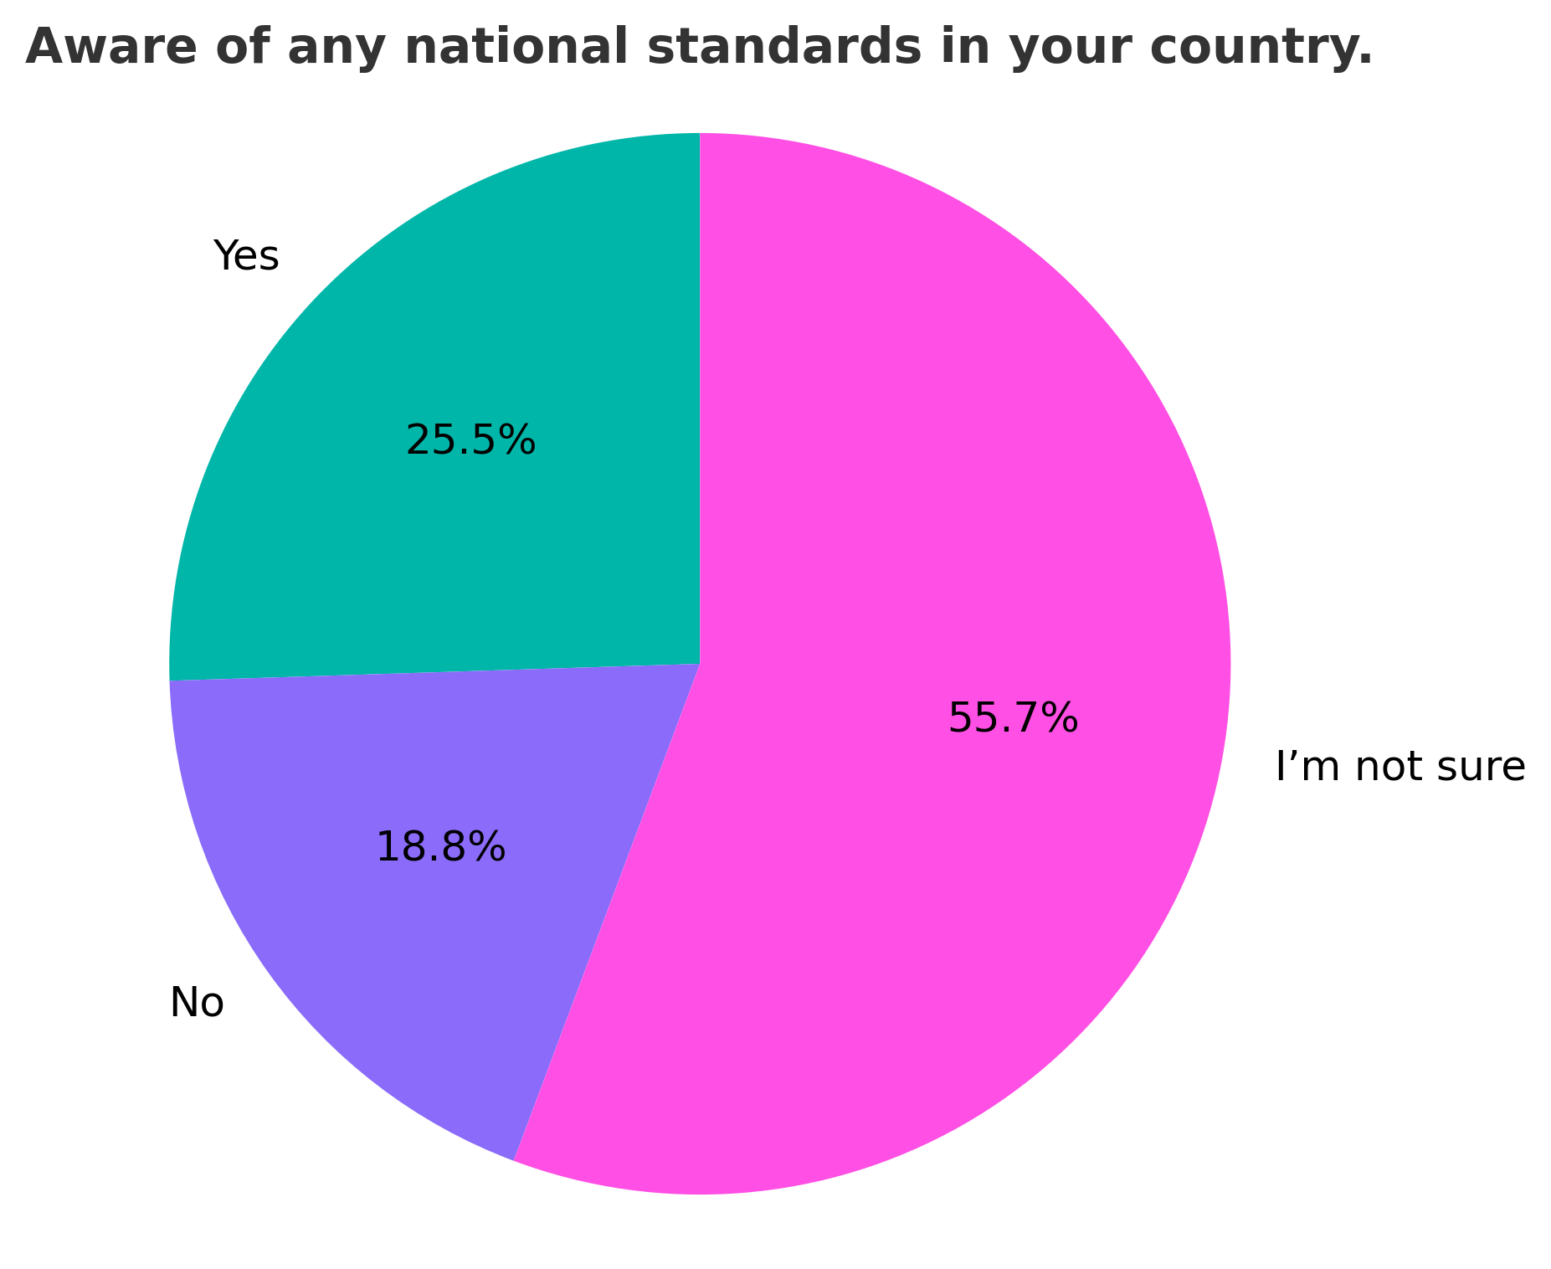
EU-COMP collection of curricula for professionals training
Needs assessment:
Survey
Responses: N=1087 > 658 fully completed
33 countries
Well-balanced across prevention, treatment and harm reduction (+- 30 pct)
+- 30 pct indicated to have peer experience
Majority frontline workers
Majority master’s or bachelor’s degree

Slide 11


Your Learning Platform for drug-related knowledge and practice
We support knowledge exchange and professional development for those working in the drugs field across the European Union and beyond.
PLATO offers flexible, practice-oriented learning to strengthen:
    Professional practice
    Knowledge exchange
    Informed decision-making
    Effective public health and policy responses

Slide 12
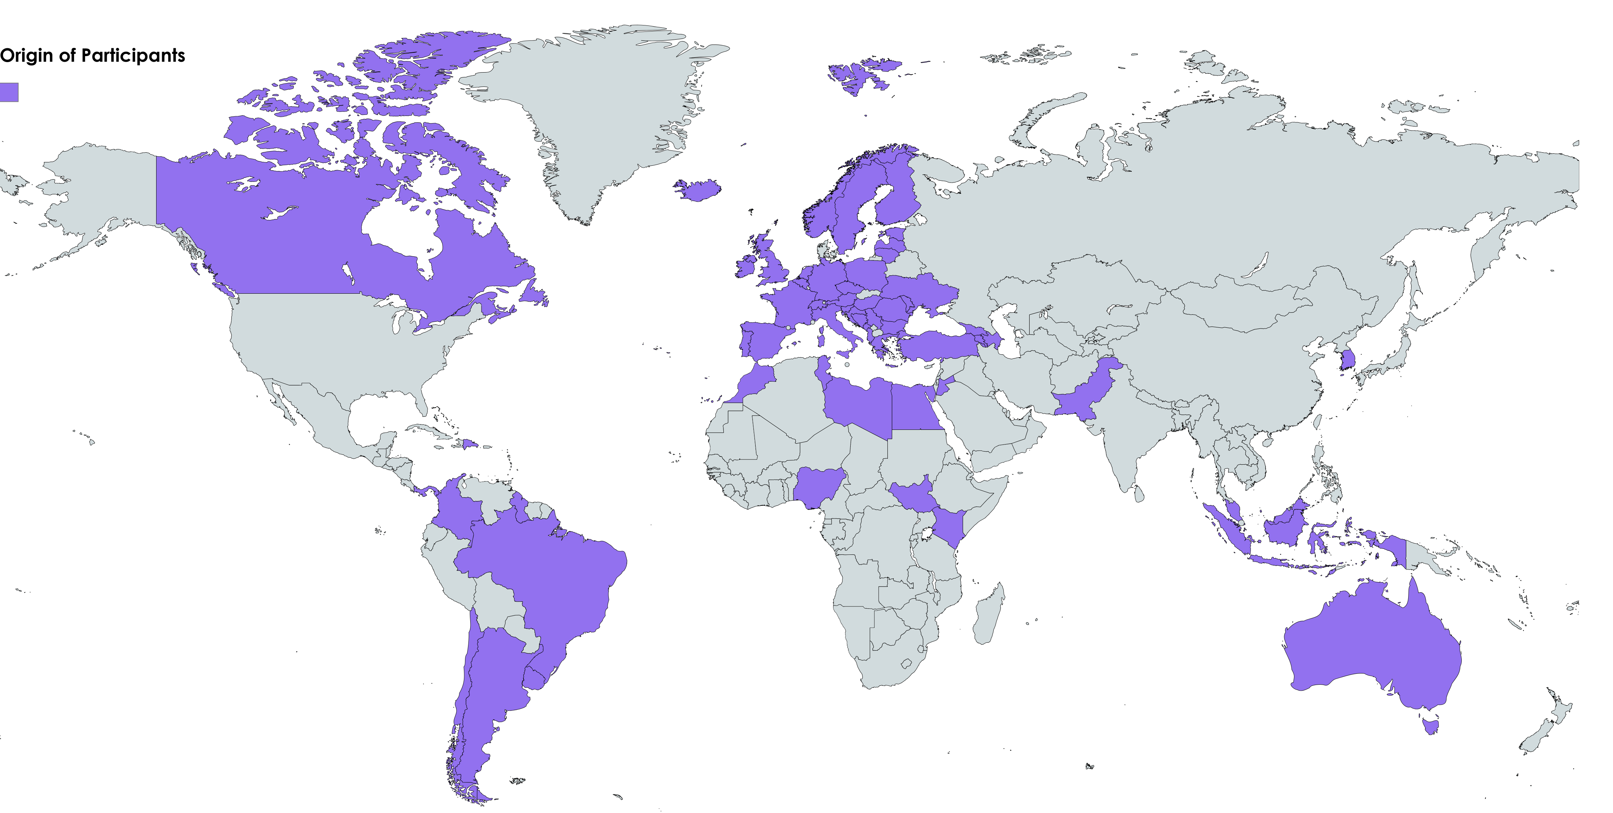
Featured Course:
European Prevention Curriculum (EUPC)
Aim:
Equip decision-, opinion-, and policymakers with practical skills and knowledge to promote and implement effective, evidence-based prevention strategies at various societal levels.
Driving change since 2021:
    More than 100 professionals trained and 100 currently in training
    5 successful past cohorts and 3 current ones
    Participants representing over 65 countries
    Strengthened skills of participants with 0 to 30 years of prior experience
    Bringing together experts from prevention, public health, policy, education, research, and project leadership fields
Notes:
Current Trainings:
Cohort #6: 01/07 - 14/10
Cohort #7: 08/09 – 21/11
Cohort #8: 29/09 – 03/12

Slide 13
Forthcoming modules on futures exercises;
Sharing responsibility of Prevention with law enforcement professionals;
Managing co-morbidity and dual diagnosis.
Notes:
Current Trainings:
Cohort #6: 01/07 - 14/10
Cohort #7: 08/09 – 21/11
Cohort #8: 29/09 – 03/12

Slide 14

Join our Winter and Summer School 2026
Started in 2011
Providing 6 Academic Credits;
Welcoming professionals from 70 world countries
Over 1000 professionals trained
Lively alumni community
2026 Winter School dates:
23rd of February 6 of March 2026
Early bird 30 October until 31st December 2025
Registrations until 16 of February 2026
Theme: The Role of Social Networks in Health and Social Responses to Drugs
Summer School dates:
22 June- 3 of July 2026
Early birds 30 October –31st of March 2026
Registrations until 38th of June 2026
Theme: From Awareness to Action: A Whole-of-Society Approach to Drugs

Slide 15
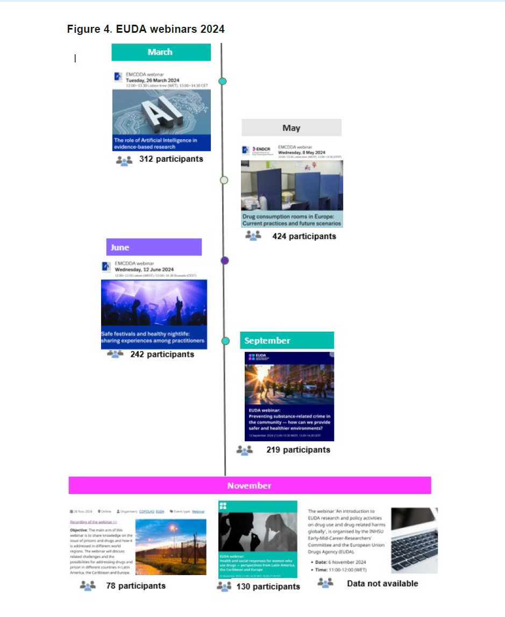
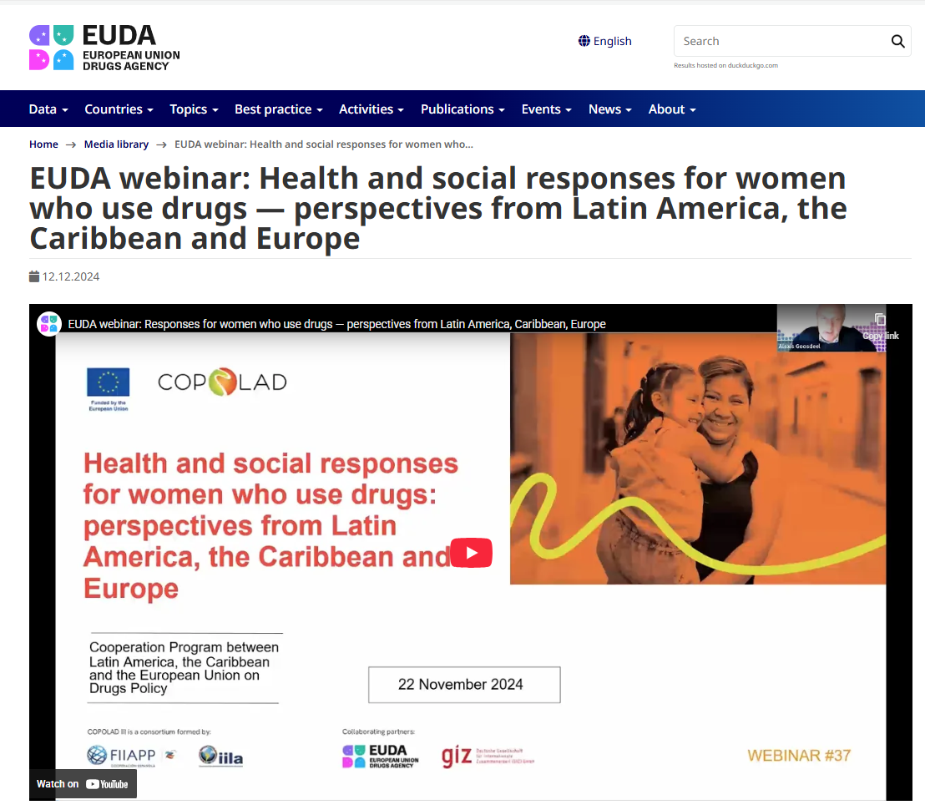
Follow our monthly webinars – over 150000 participants

Slide 16

EUDA Health and Social Responses Newsletter_en
Scan the QR-Code to stay updated on all matters regarding our Best Practice Portal, the X-Change Database, and much more!

Slide 17
Thank you
Acting today, anticipating tomorrow.
For more information please contact:
Marica Ferri
Marica.ferri@euda.europa.eu

